Slide 1

Fundamentals of
Azure SQL Database
Deepthi Goguri

Slide 2
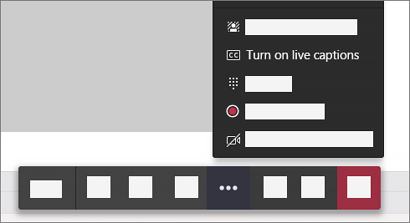
Foreword for MS Teams 📌
For zooming in, use CTRL + MOUSE WHEEL
Move around with mouse dragging
Live closed captions in upper right in MS Teams
Works for English only at the moment 😑
Source: Microsoft documentation
Notes:
Source: https://support.microsoft.com/en-us/office/use-live-captions-in-a-teams-meeting-4be2d304-f675-4b57-8347-cbd000a21260?ui=en-US&rs=en-US&ad=US

Slide 3
Speaker Intro
Deepthi Goguri - @dbanuggets
Kentucky, USA
SQL Server DBA
MCT, MCSE
Masters in Computer Technology @eiu
My personal blog is at https://dbanuggets.com/
Notes:
Before we jump in here is a brief introduction to me
I have 10+ years experience in IT
I am currently the Senior Ops Engineer at Kainos in Belfast
I am an Azure Certified Solutions Architect
I blog on all things Azure at thomasthornton.cloud

Slide 4
Agenda
Deployment options
Service tiers
Demo
Takeaway’s
Next Steps
Notes:
Todays Agenda looks like this
We are going to be discussing
Terraform and Azure DevOps.
We will also talk about Azure repos, pipelines as code, manual deployments and then automating them using Terraform and Azure DevOps.
Then we will take a look at the learning resources and materials we have found useful when learning Terraform and whilst using Azure DevOps.
And to round off if we will cover takeaways from this session and then open it up to any questions you have.
If you have questions during the session please type them in chat and Gregor will try to either answer them or ask me during the session.

Slide 5
Why I Started learning Azure?
Azure is the future of cloud technologies
Companies planning to migrate quickly
DBA role going to expand
Learning Azure provides great career opportunities
Much value to the Azure certifications

Slide 6
Deployment options
SQL Server on Azure VM (IaaS)
Azure SQL Managed Instance (PaaS)
Azure SQL Database (PaaS)
@dbanuggets

Slide 7

SQL Server on Azure VM
Access to OS and SQL Server instance
Choose SQL and OS versions
Automate backups and security patches
Extended security updates for older versions of SQL Server
Use Images to take advantage of SQL IaaS extension (automate management and administration tasks)

Slide 8
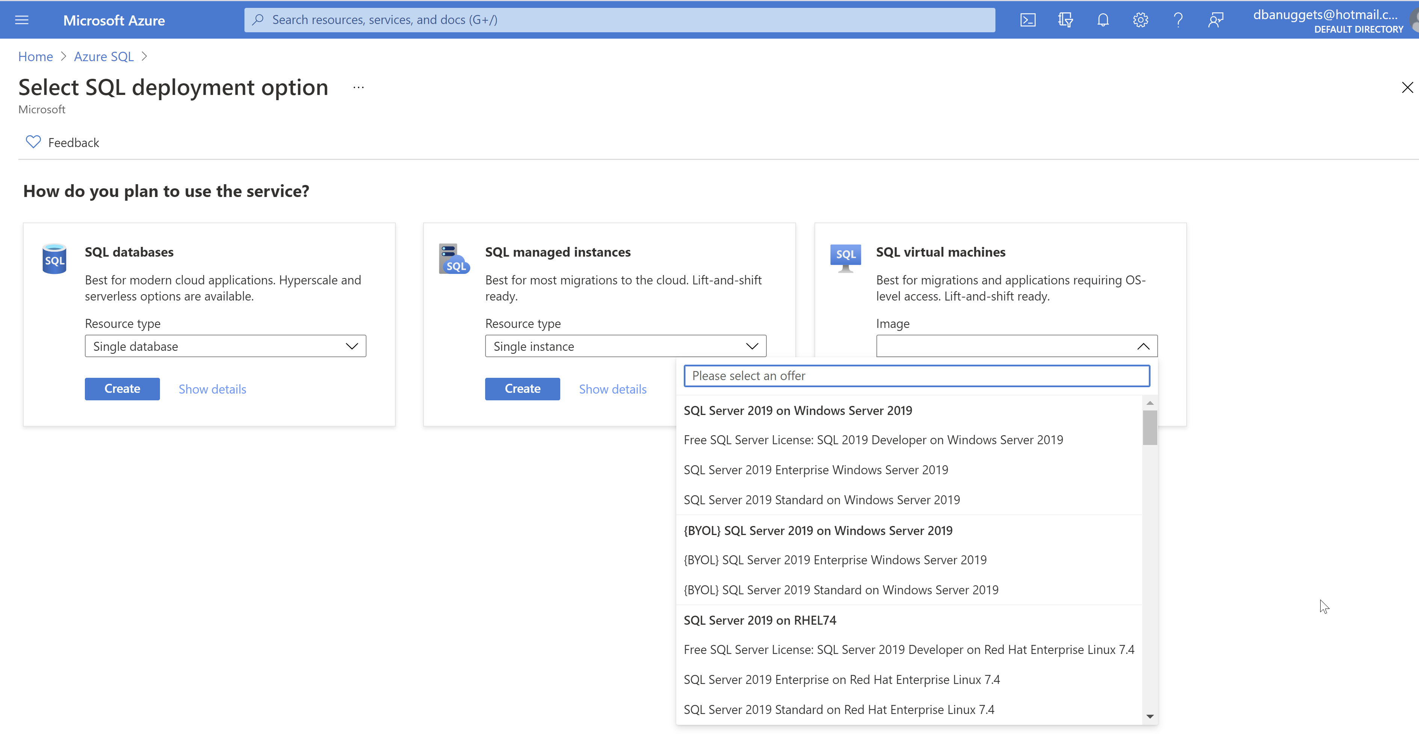
Images

Slide 9

SQL Managed Instance
Instance scoped features
SQL Server agent, service broker, dbmail, linked servers etc.
OS is taking care of by Microsoft
Notes:
What is and why is it differences?

Slide 10

Azure SQL Database
Database only
Full recovery model
Modern cloud applications
Azure SQL DB up to 4TB
Hyperscale (100TB)
No SQL Server agent
SLA of 99.995%
Notes:
What is Azure SQL – how is it differ from the rest?

Slide 11
Comparison
Feature | Azure SQL Database | Azure SQL Managed Instance
Change data capture (CDC) | NO | YES
Common language runtime (CLR) | NO | YES
Cross-database/three-part name queries | NO | YES
Cross-database transactions | NO | YES
Database mail | NO | YES
Resource Governor | NO | YES
Automatic tuning (indexes) | YES | NO
SQL Server agent | NO | YES
For all Feature differences: https://docs.microsoft.com/en-us/azure/azure-sql/database/features-comparison

Slide 12
Uses of Azure SQL
Build applications quickly
Reduce the costs
No need of physical hardware
No patching
Built in High availability
Performance, scalability, security

Slide 13
Is your data secure?
Firewall rules
Private endpoints
Notes:
There are 3 different 0fferings fo SQL Sever in Azure
SQL server on VM’s
Azure SQL
Managed instance
What are they and why are they different
Cost
Easy of use
deployment

Slide 14
How can we deploy it?
You can deploy All 3 using the following:
From the Azure Portal
Azure CLI
Infrastructure as code (Powershell, Pulumi, Terraform or Bicep)
Notes:
You can deploy All 3 using the following:-
From the Azure Portal
Azure CLI
Infrastructure as code (Pulumi, Terraform or Bicep)

Slide 15
How much does it cost?
Purchasing models
DTU (bundle of compute, storage and I/O)
Basic, standard and premium
vCore (choose compute and storage separately)
General purpose, hyperscale and business critical
Azure hybrid benefit
Reserved capacity
SQL managed instance only option
Source: https://docs.microsoft.com/en-us/azure/azure-sql/database/migrate-dtu-to-vcore
Notes:
Mention Azure Calculator
https://azure.microsoft.com/en-gb/pricing/calculator/

Slide 16
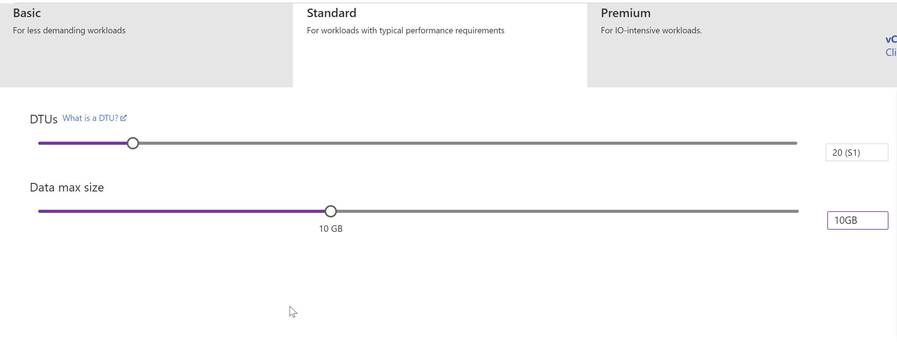
DTU
https://docs.microsoft.com/en-us/azure/azure-sql/database/service-tiers-dtu

Slide 17
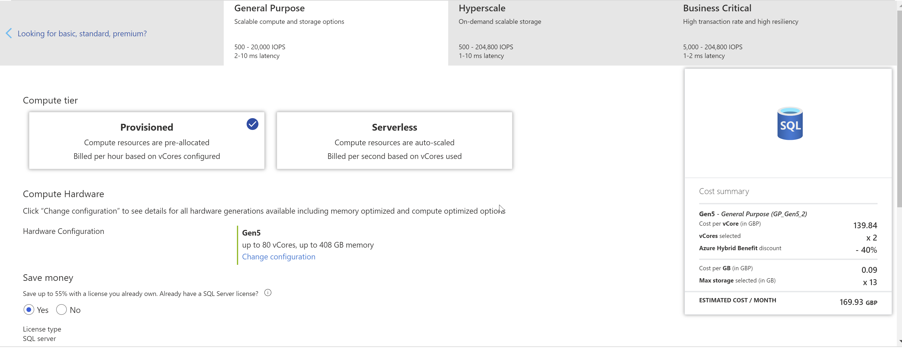
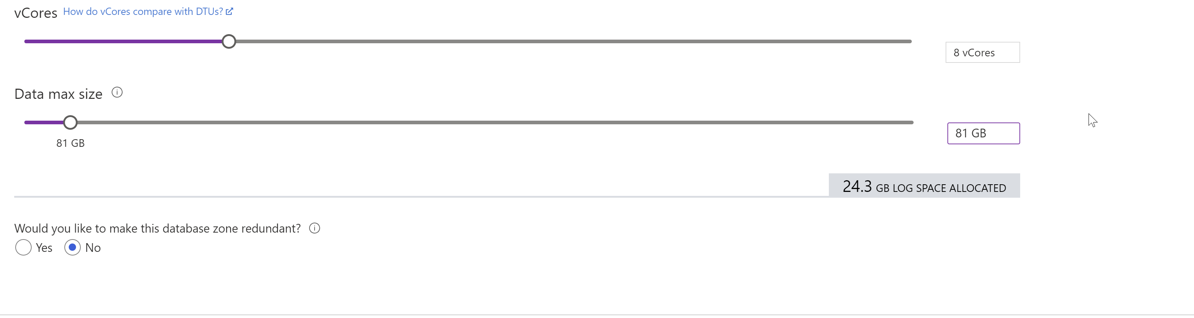
vCore

Slide 18
Service tiers
General purpose
- Most business uses
- low budget
- only one Primary
- No secondary standby
- Serverless
- Up to 80 vCores
- Up to 4TB
Business critical
- Read workloads like reporting
- In-Memory OLTP
- Includes readable secondaries
- Low latency
- High cost
- Up to 128 vCores
-Up to 4TB
Hyperscale
- Single Azure SQL databases only
- Storages up to 100TB
- Point in time restores
- 4 readable replicas
- Up to 80 vCores
Source: https://docs.microsoft.com/en-us/azure/azure-sql/database/service-tiers-general-purpose-business-critical

Slide 19
Compute tiers
Provisioned
- Fixed resources
- Be charged regardless of these resource usage
Serverless
- Intermittent and unpredictable workloads
- Automatic compute scaling
- Min and max vCores
- Billed only for the resources used
- Automatic pausing when not used
- Pay only for storage

Slide 20
2 compute tiers
Provisioned
Serverless

Slide 21
Points to remember
“USE Databasename” doesn’t work in Azure SQL Database
Once you choose hyperscale service tier, you cannot change it back to general/business critical
We don’t mention the max data size in hyperscale. That’s automatically managed by Microsoft

Slide 22
How to create Azure SQL Database?

Slide 23
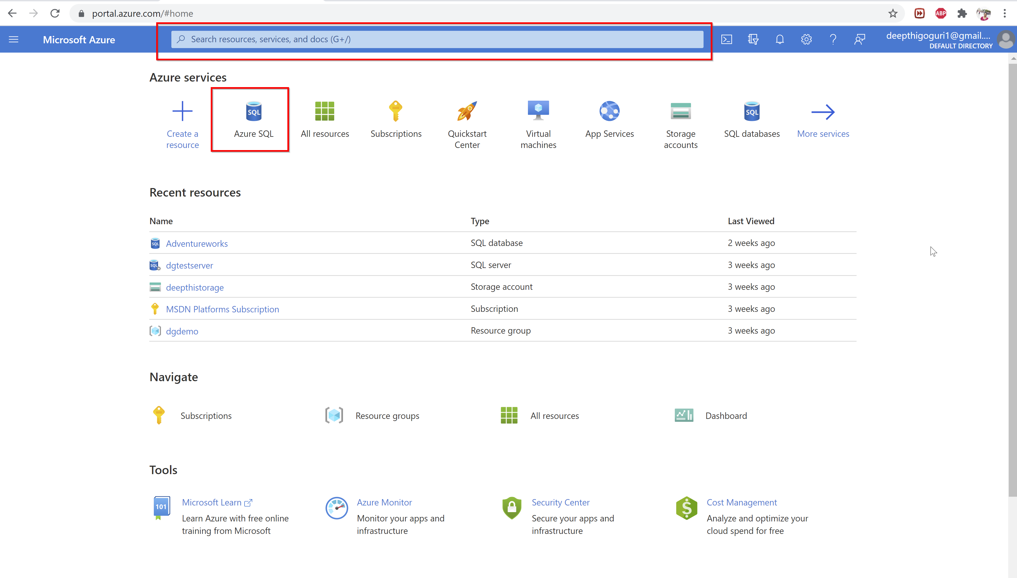

Slide 24
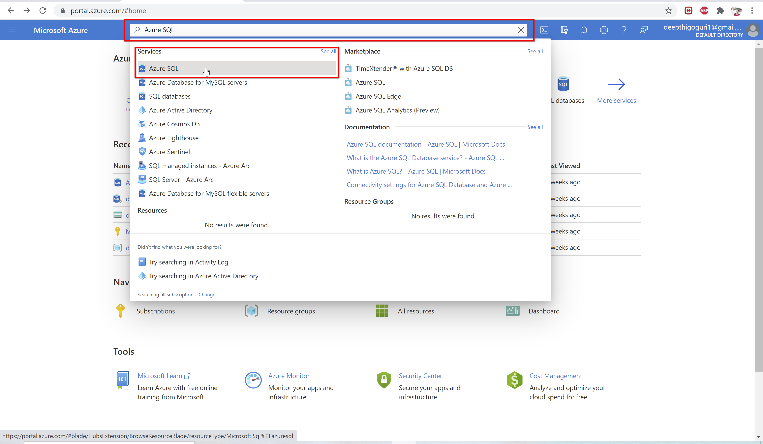

Slide 25
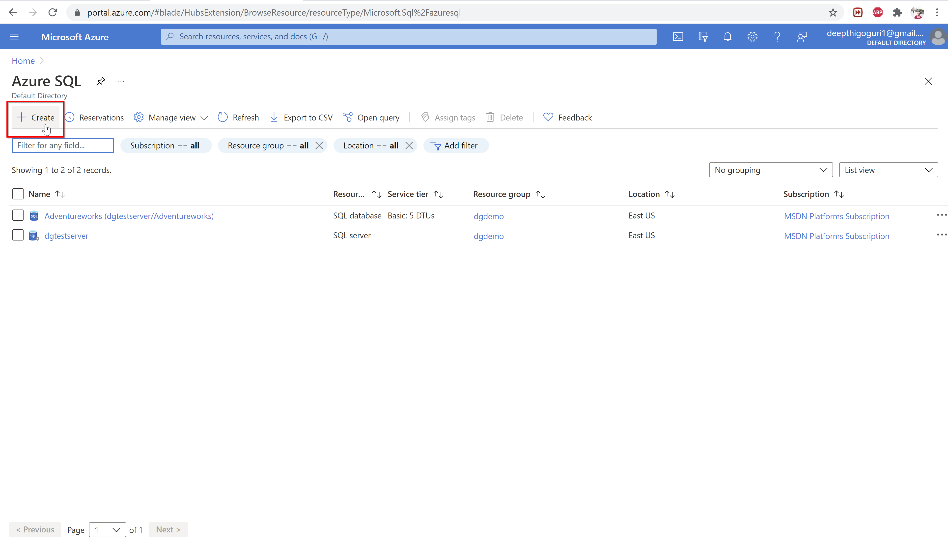

Slide 26
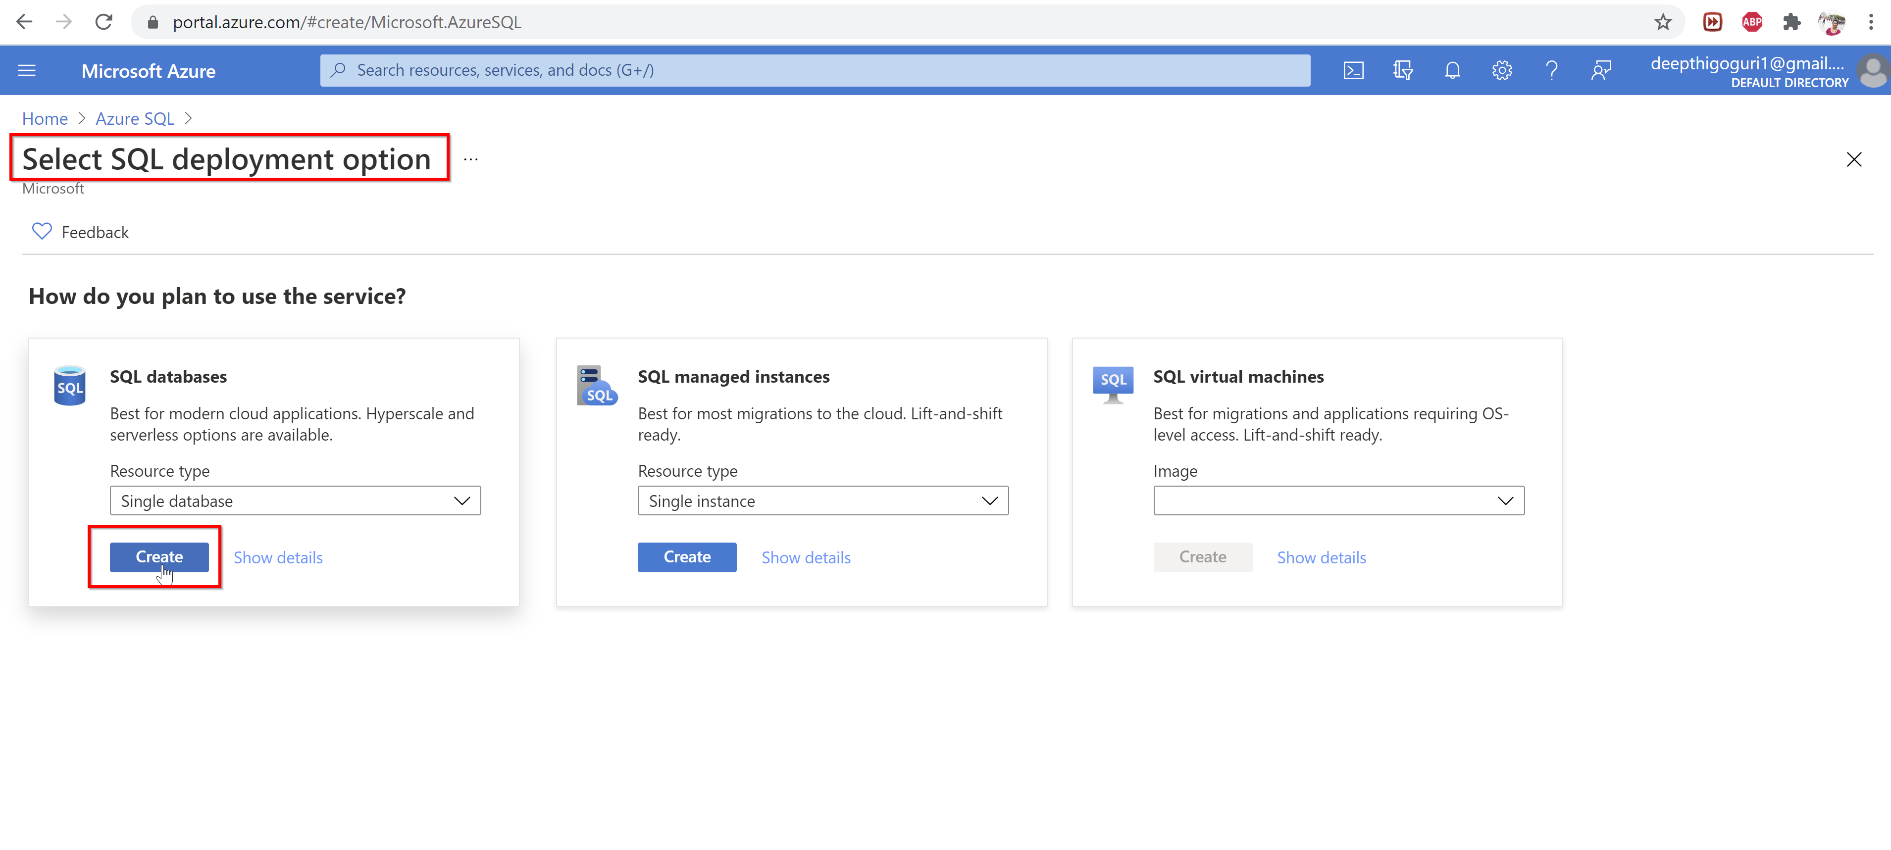

Slide 27
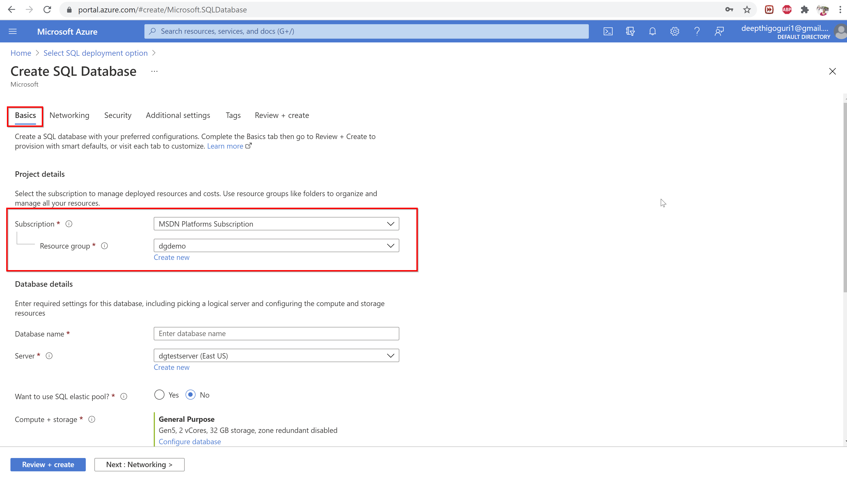

Slide 28
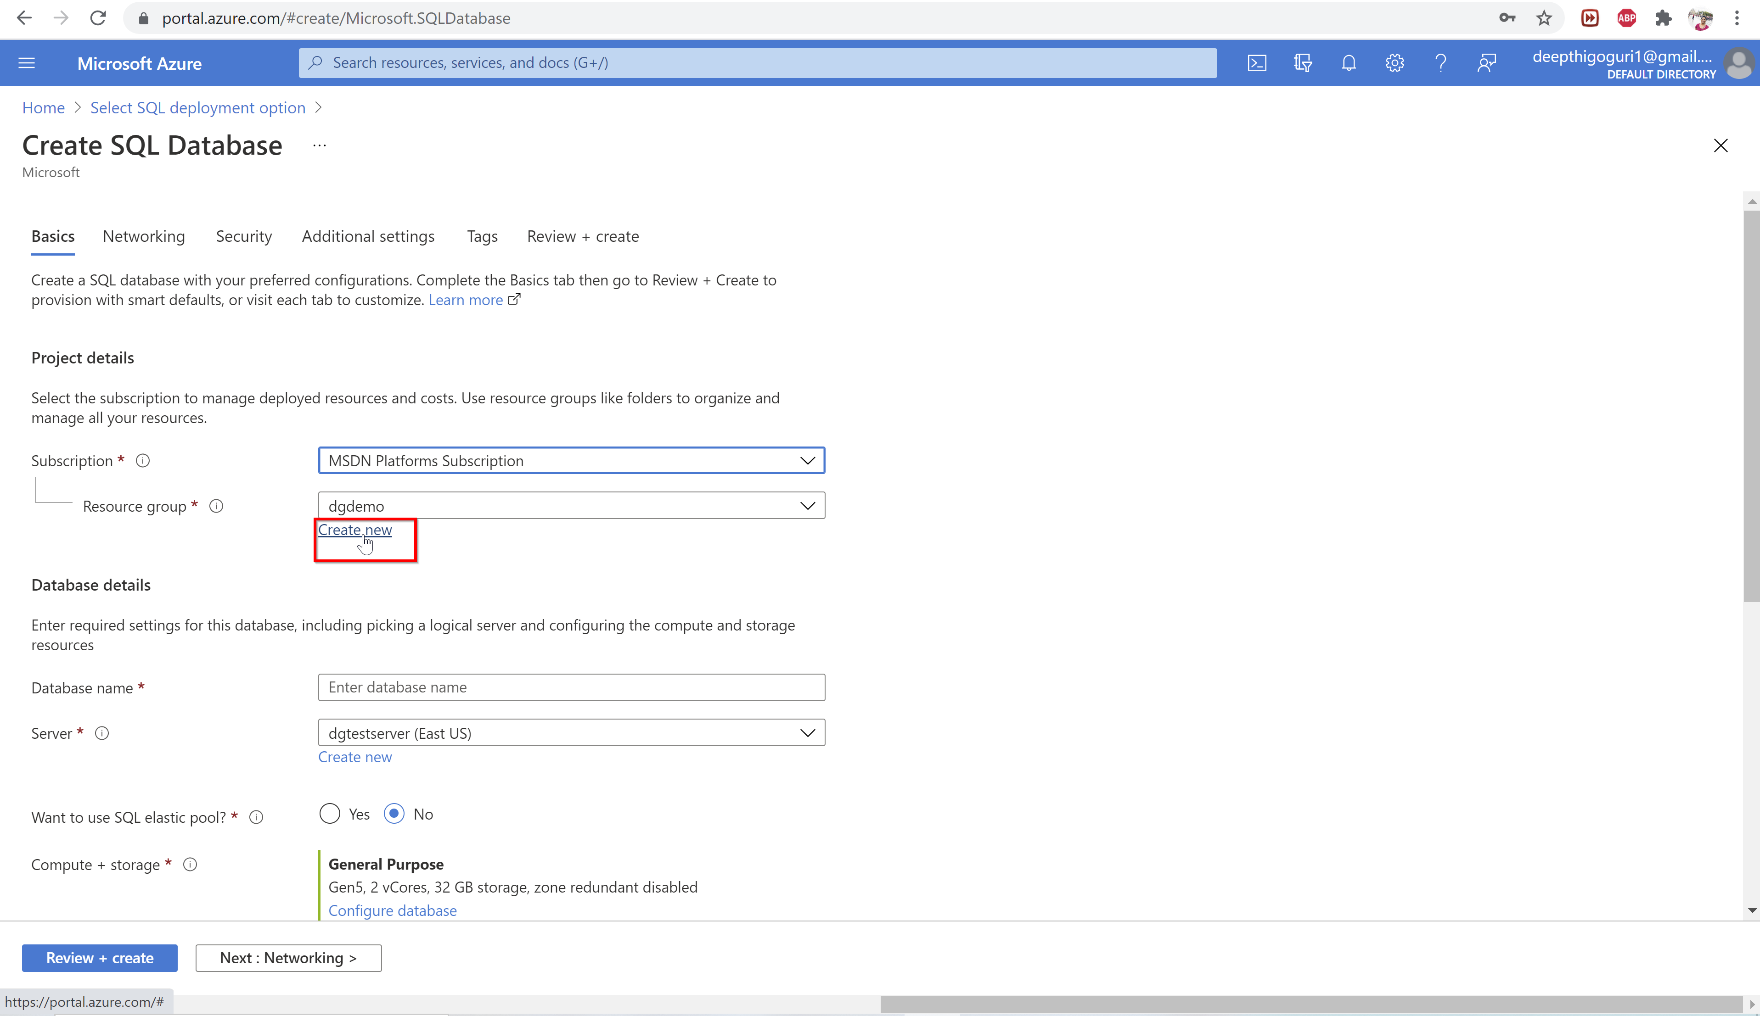

Slide 29
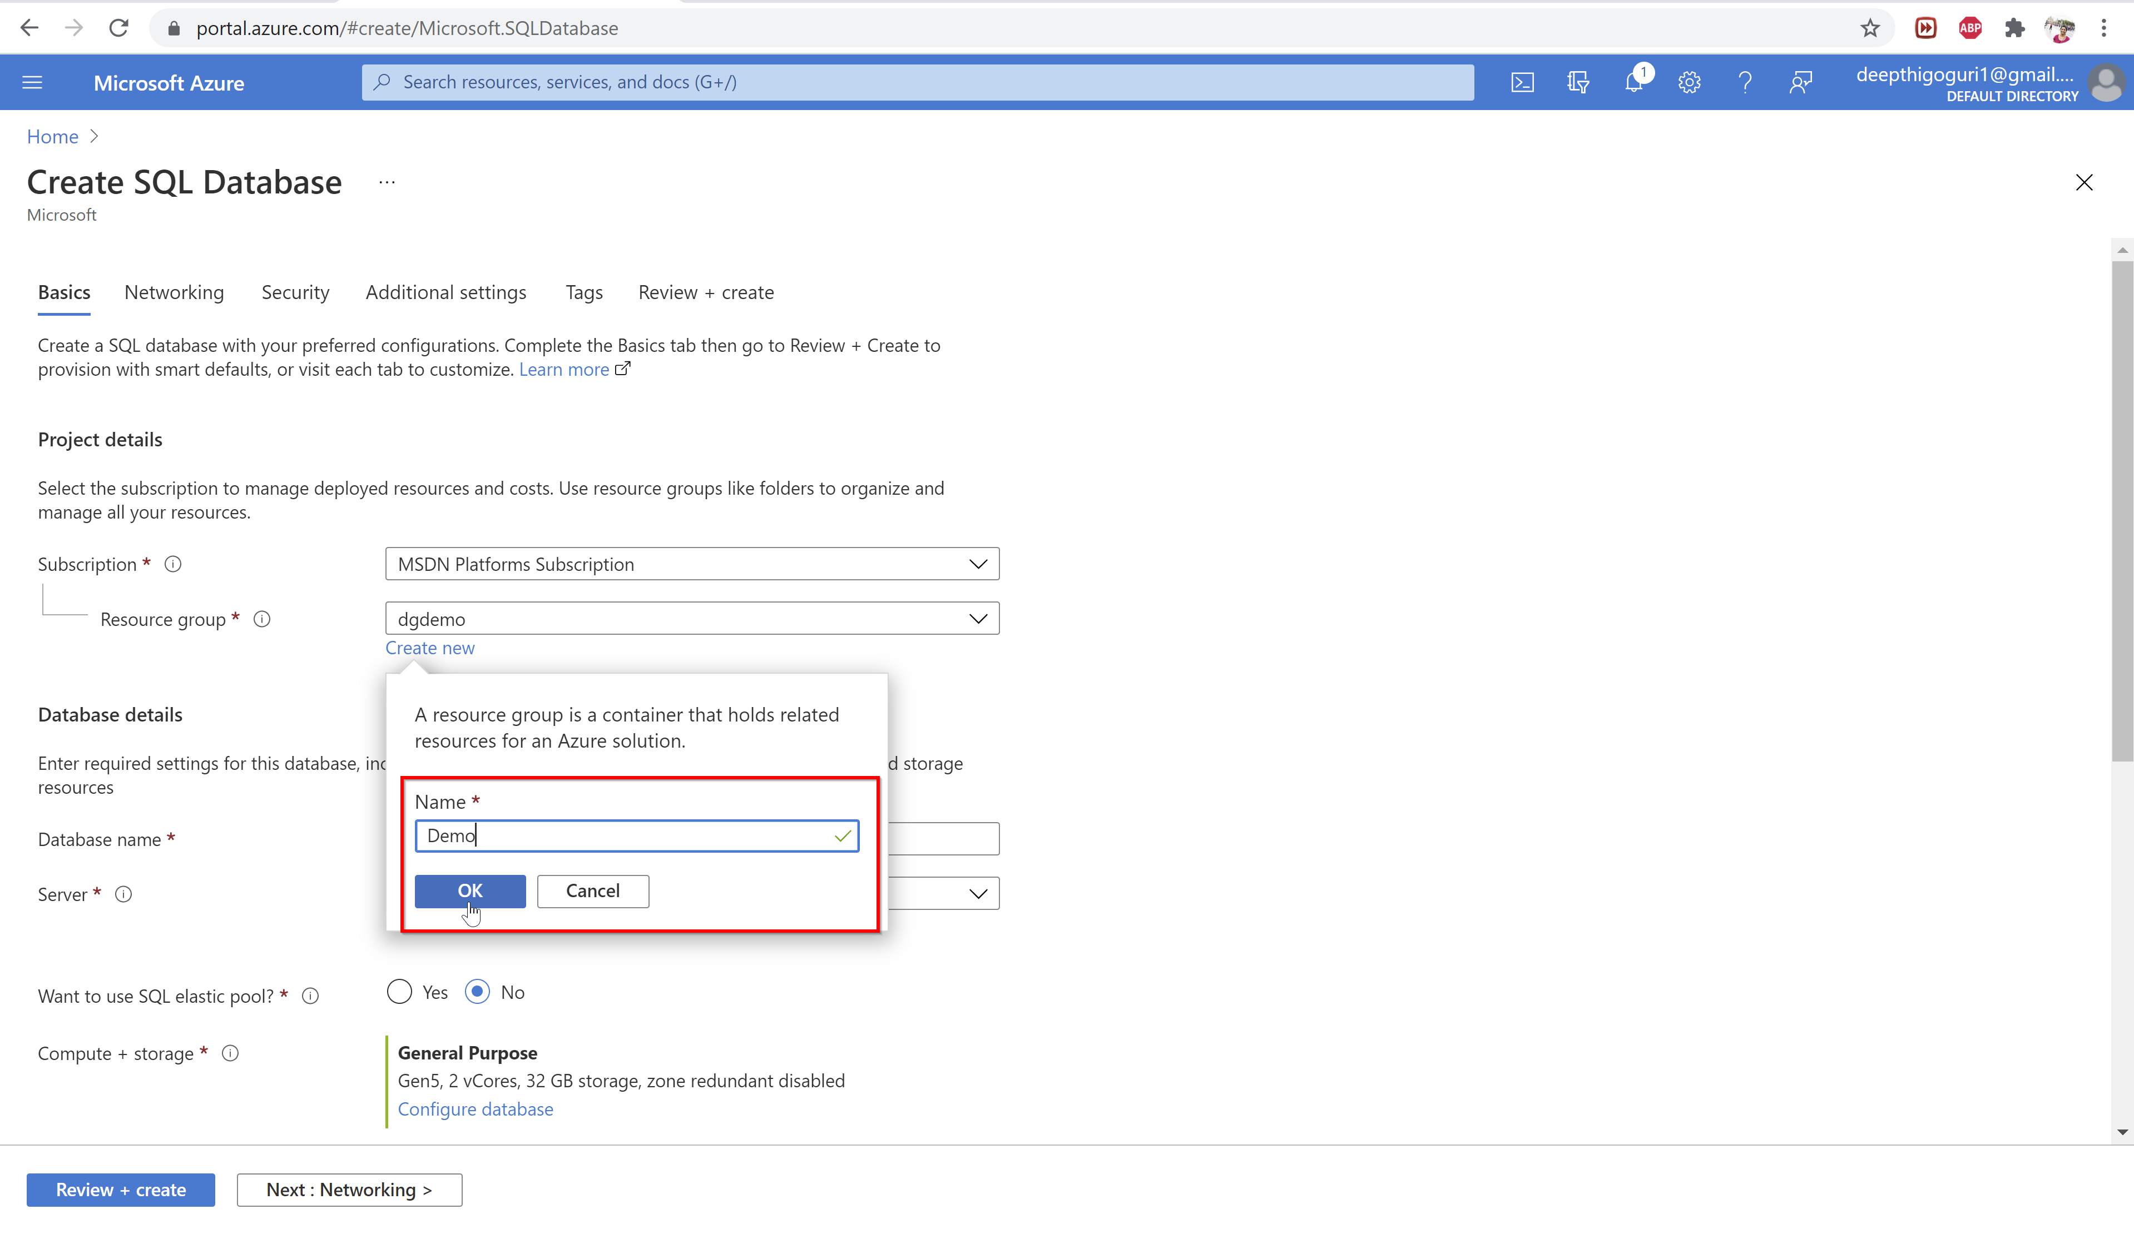

Slide 30
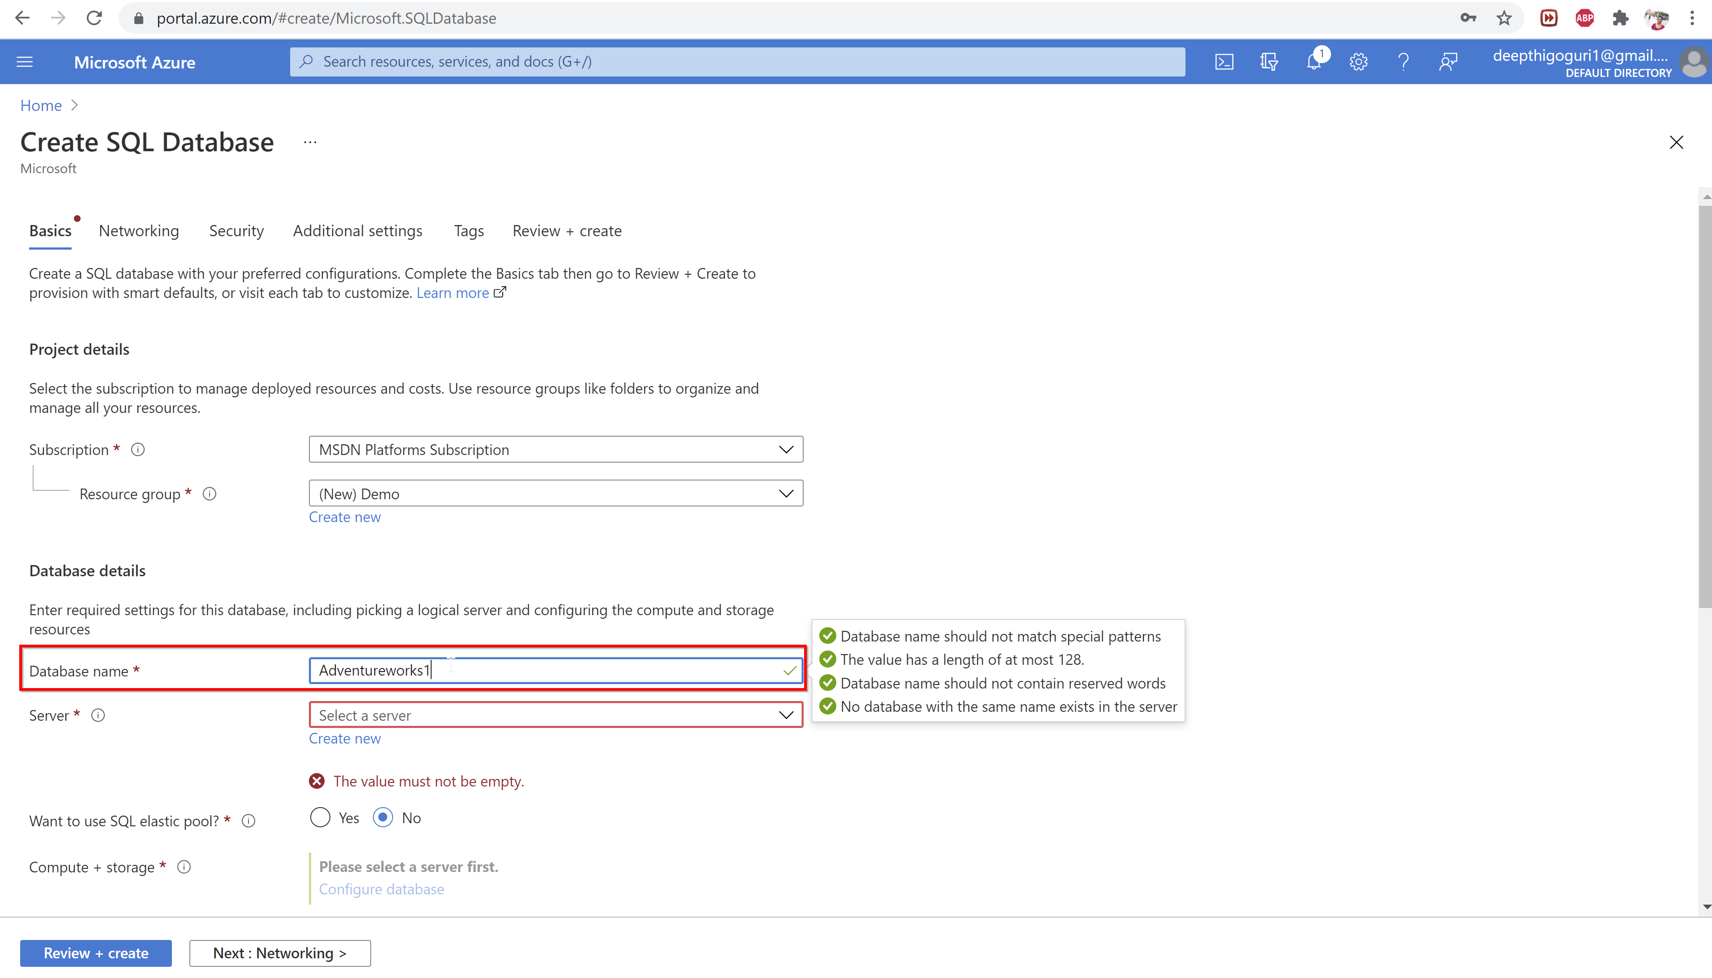

Slide 31
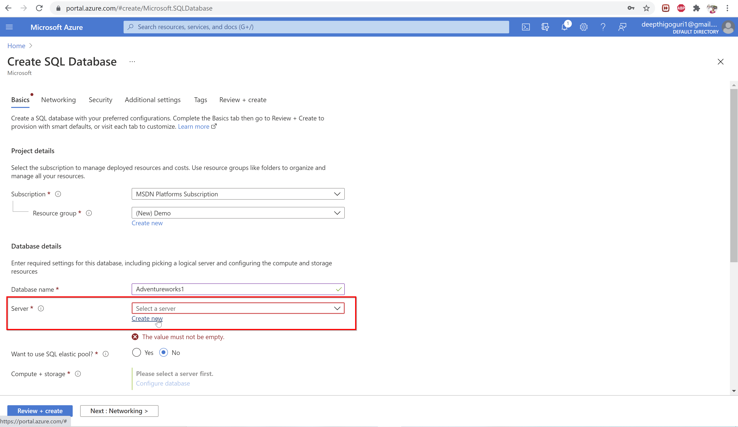

Slide 32
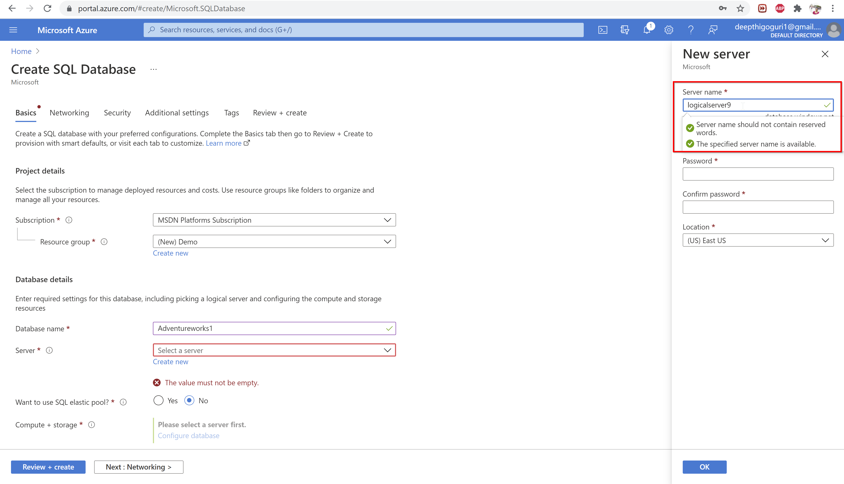

Slide 33
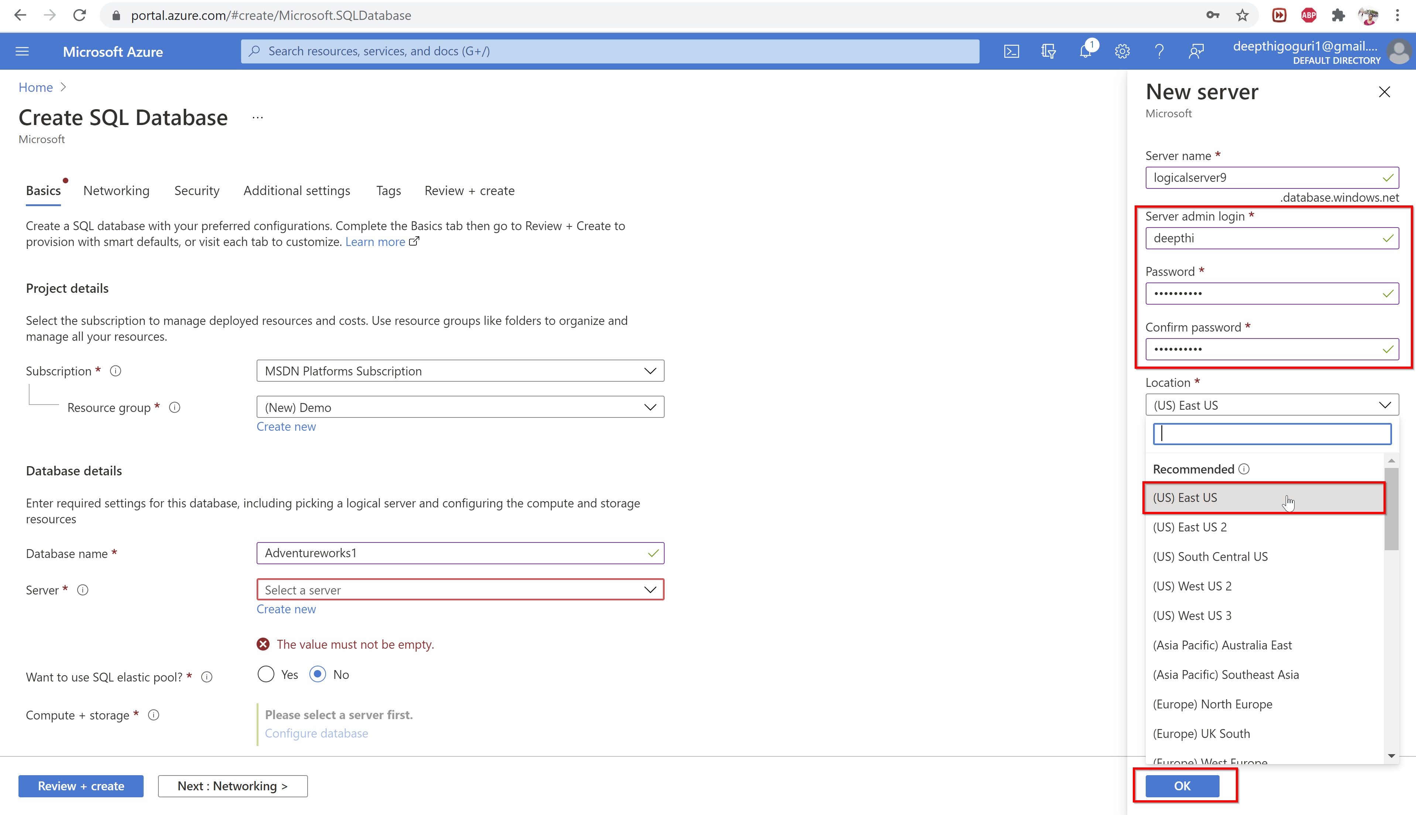

Slide 34
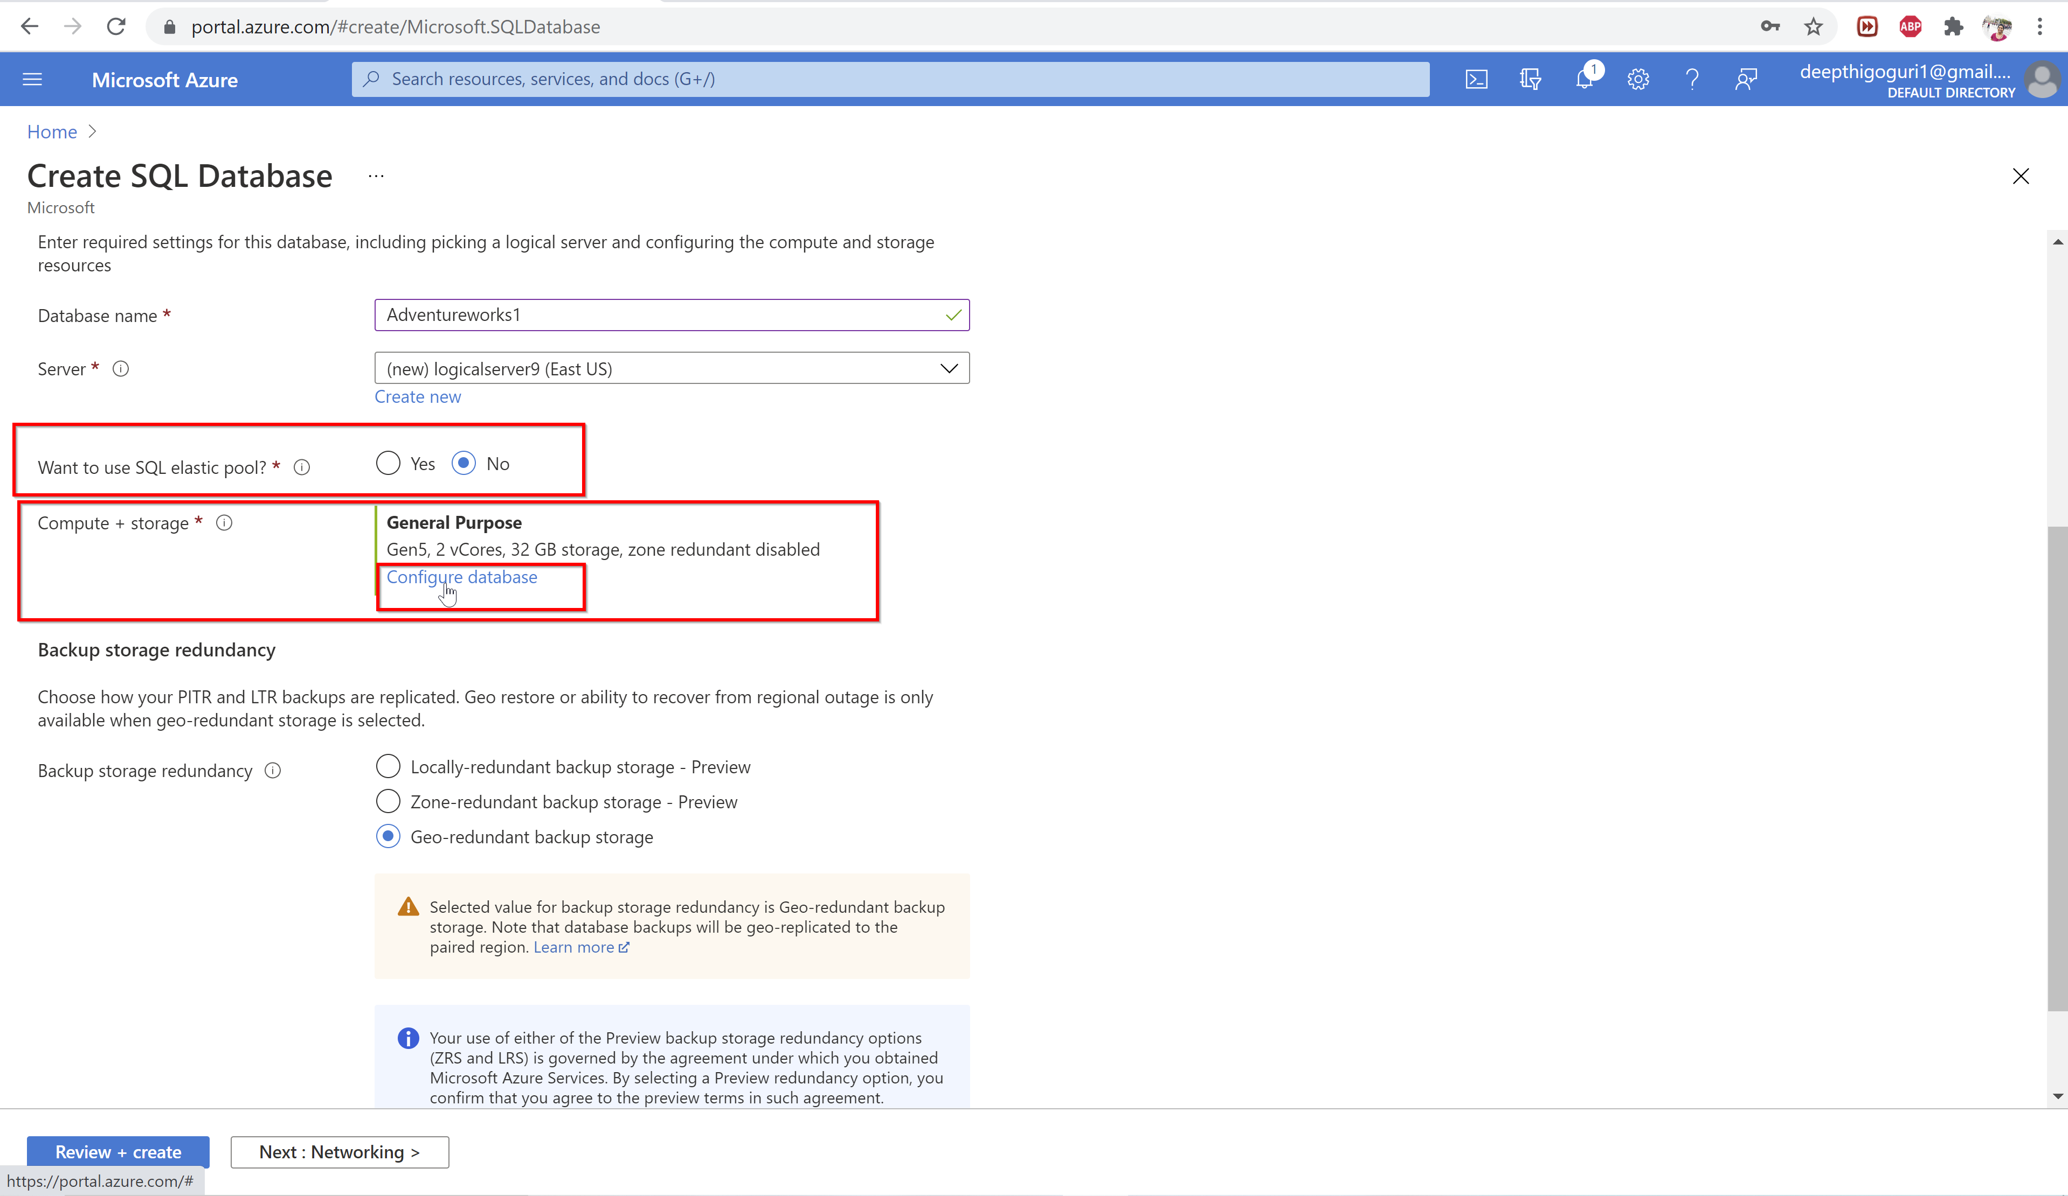

Slide 35
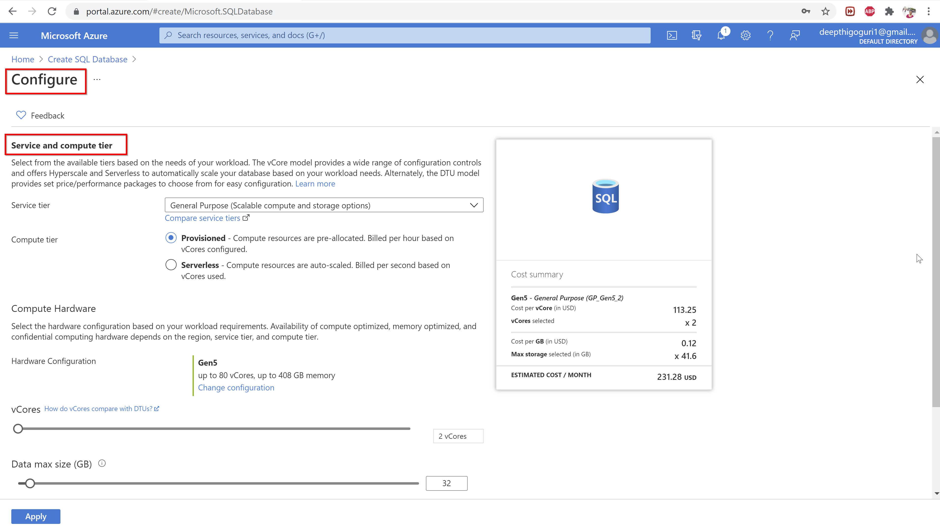

Slide 36
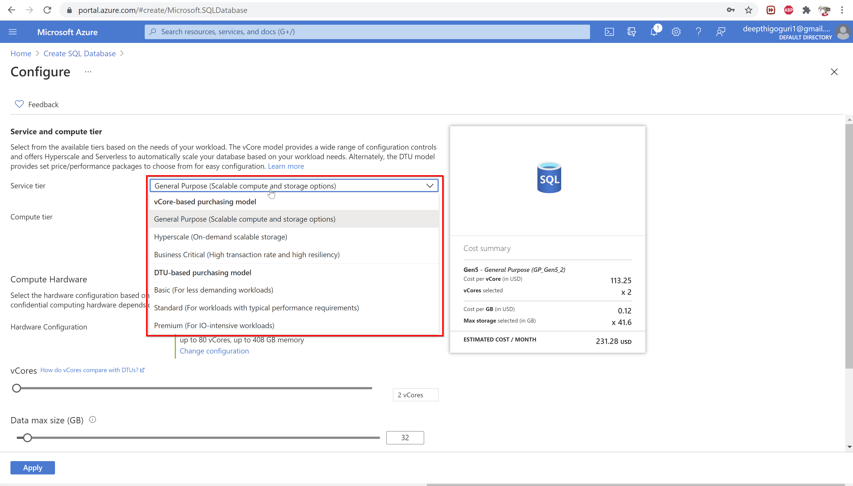

Slide 37
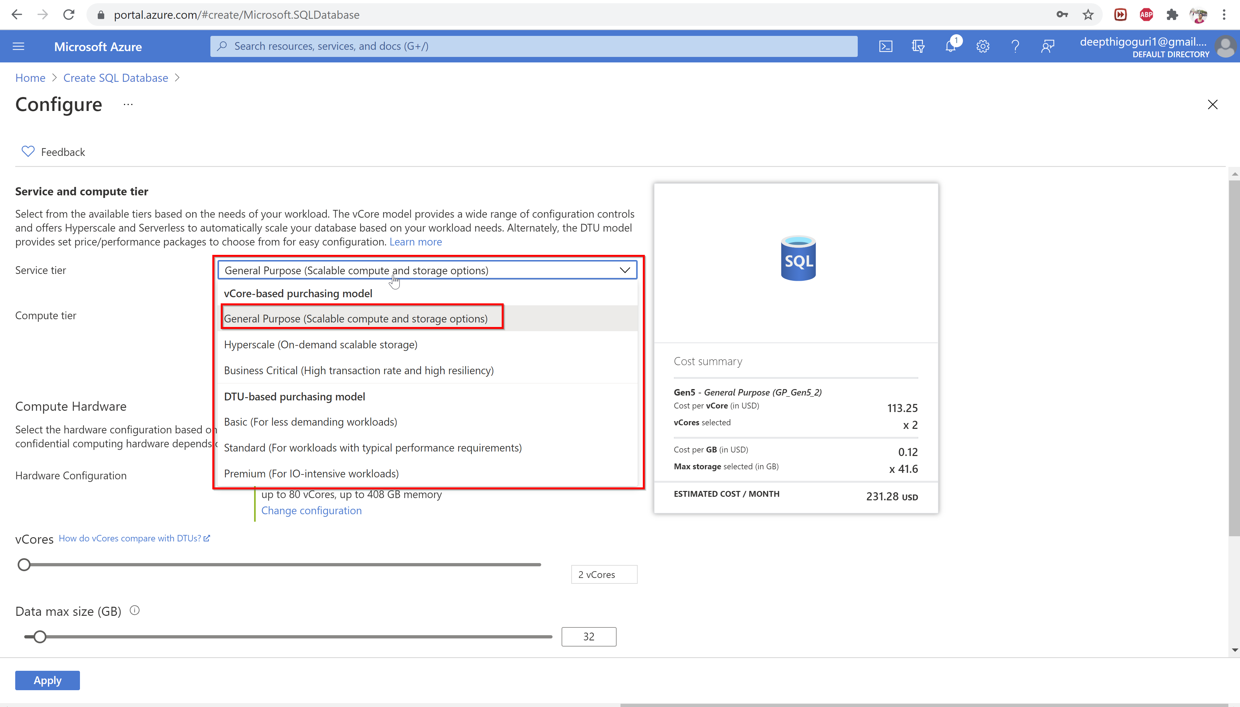

Slide 38
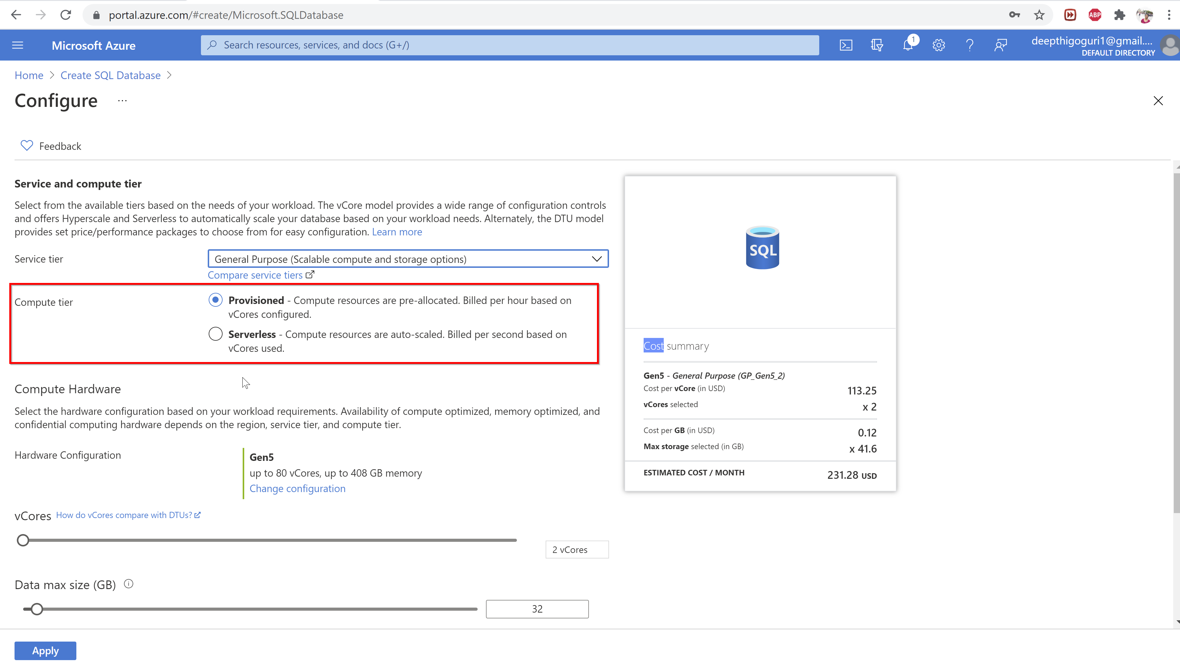

Slide 39
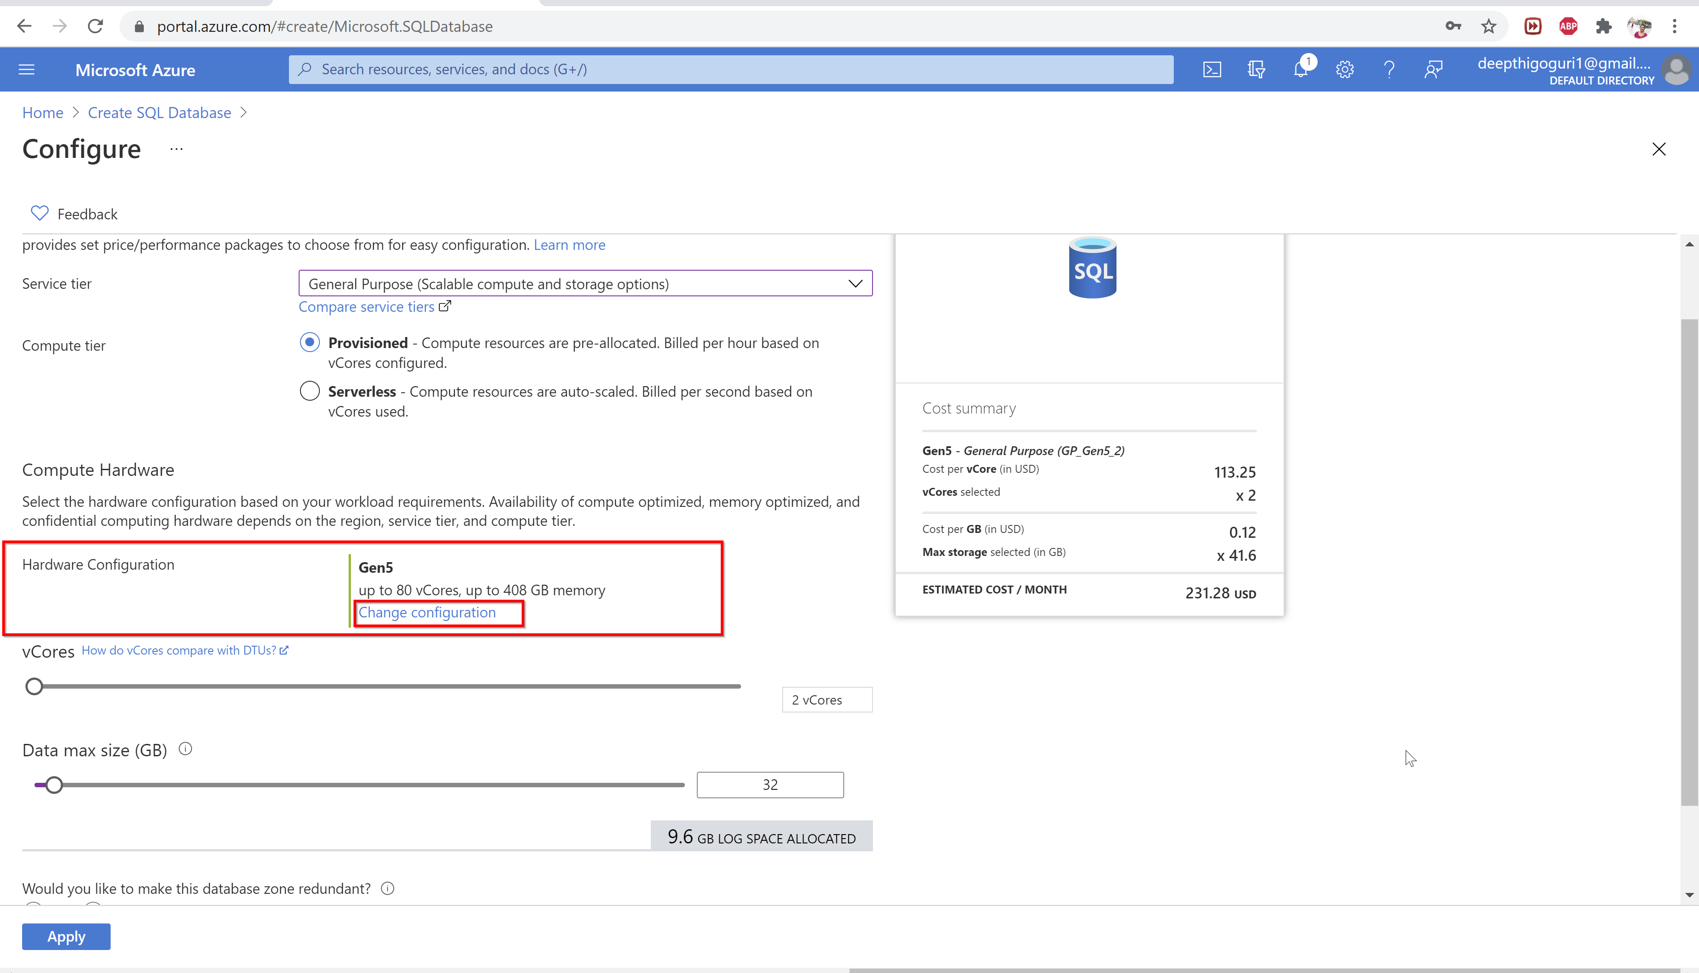

Slide 40
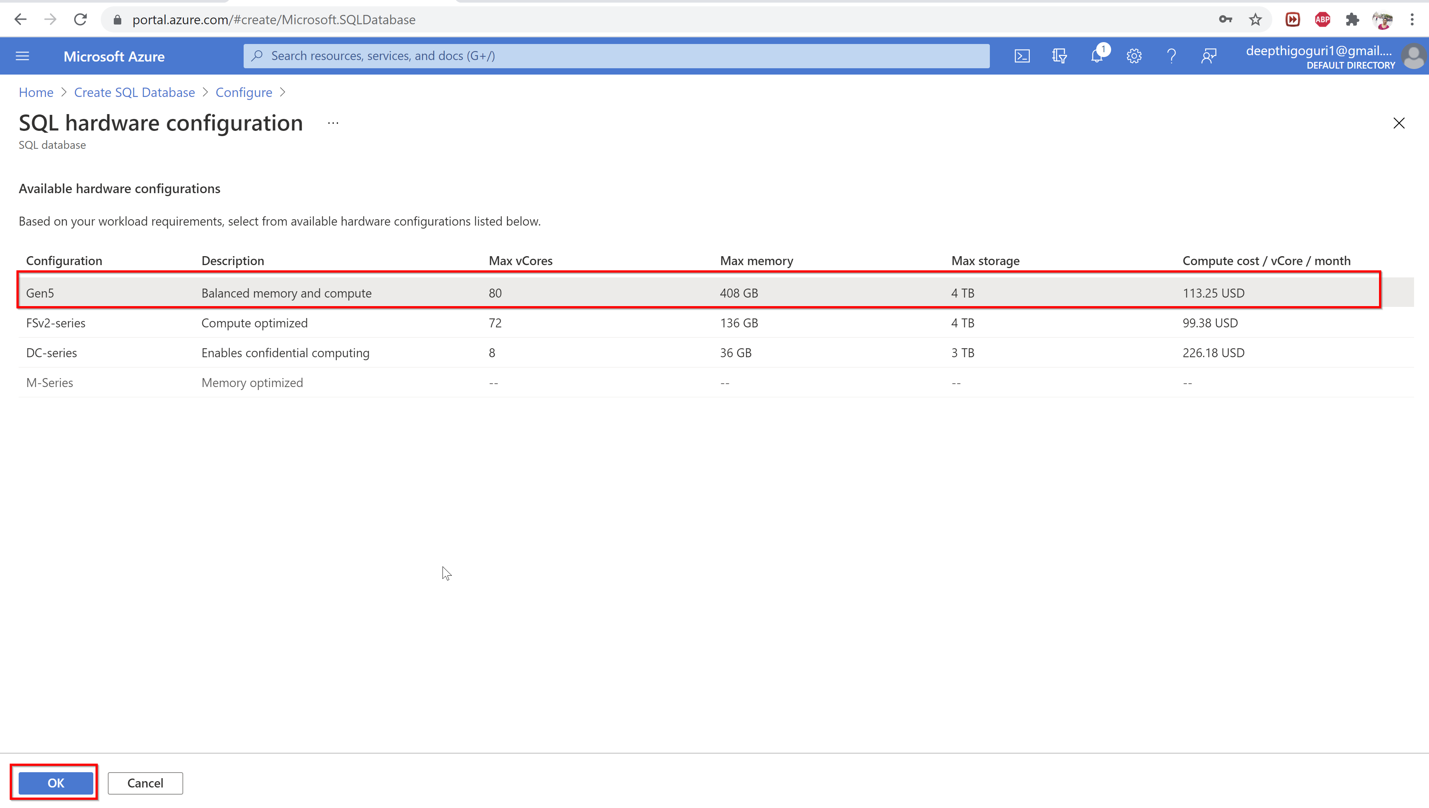

Slide 41
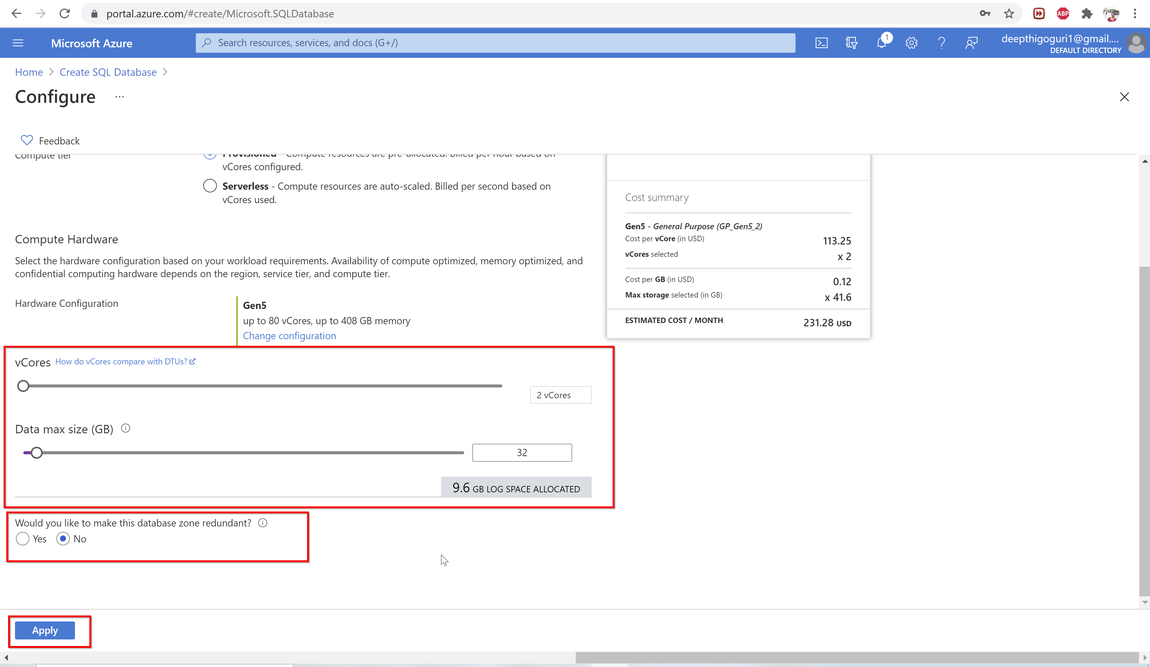

Slide 42
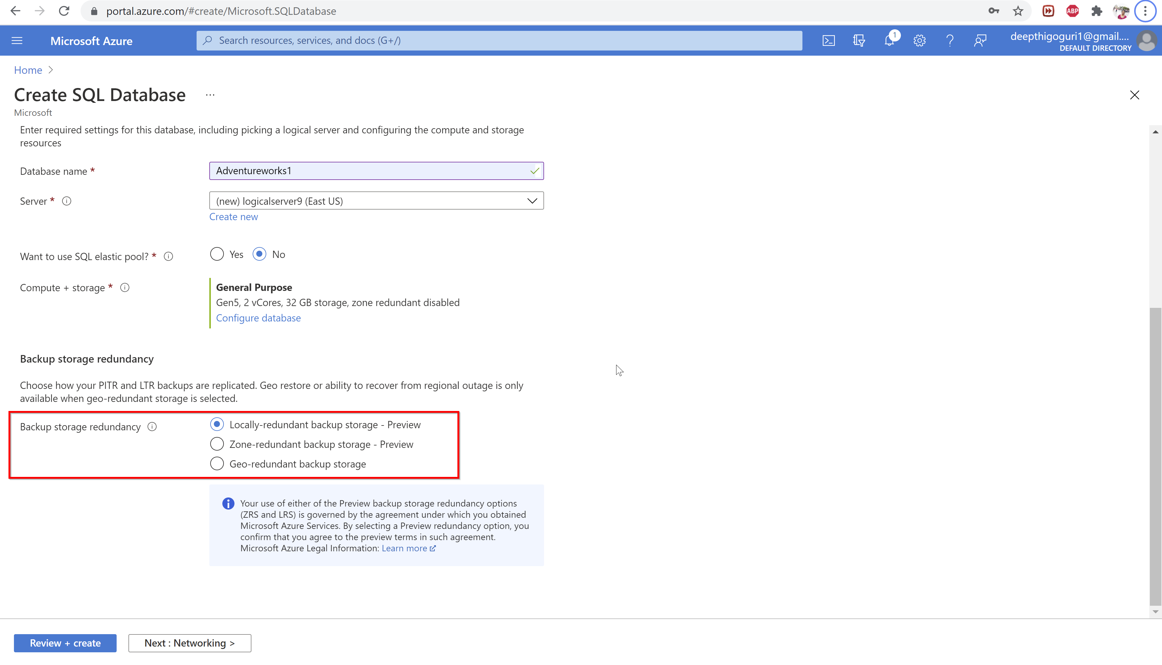

Slide 43
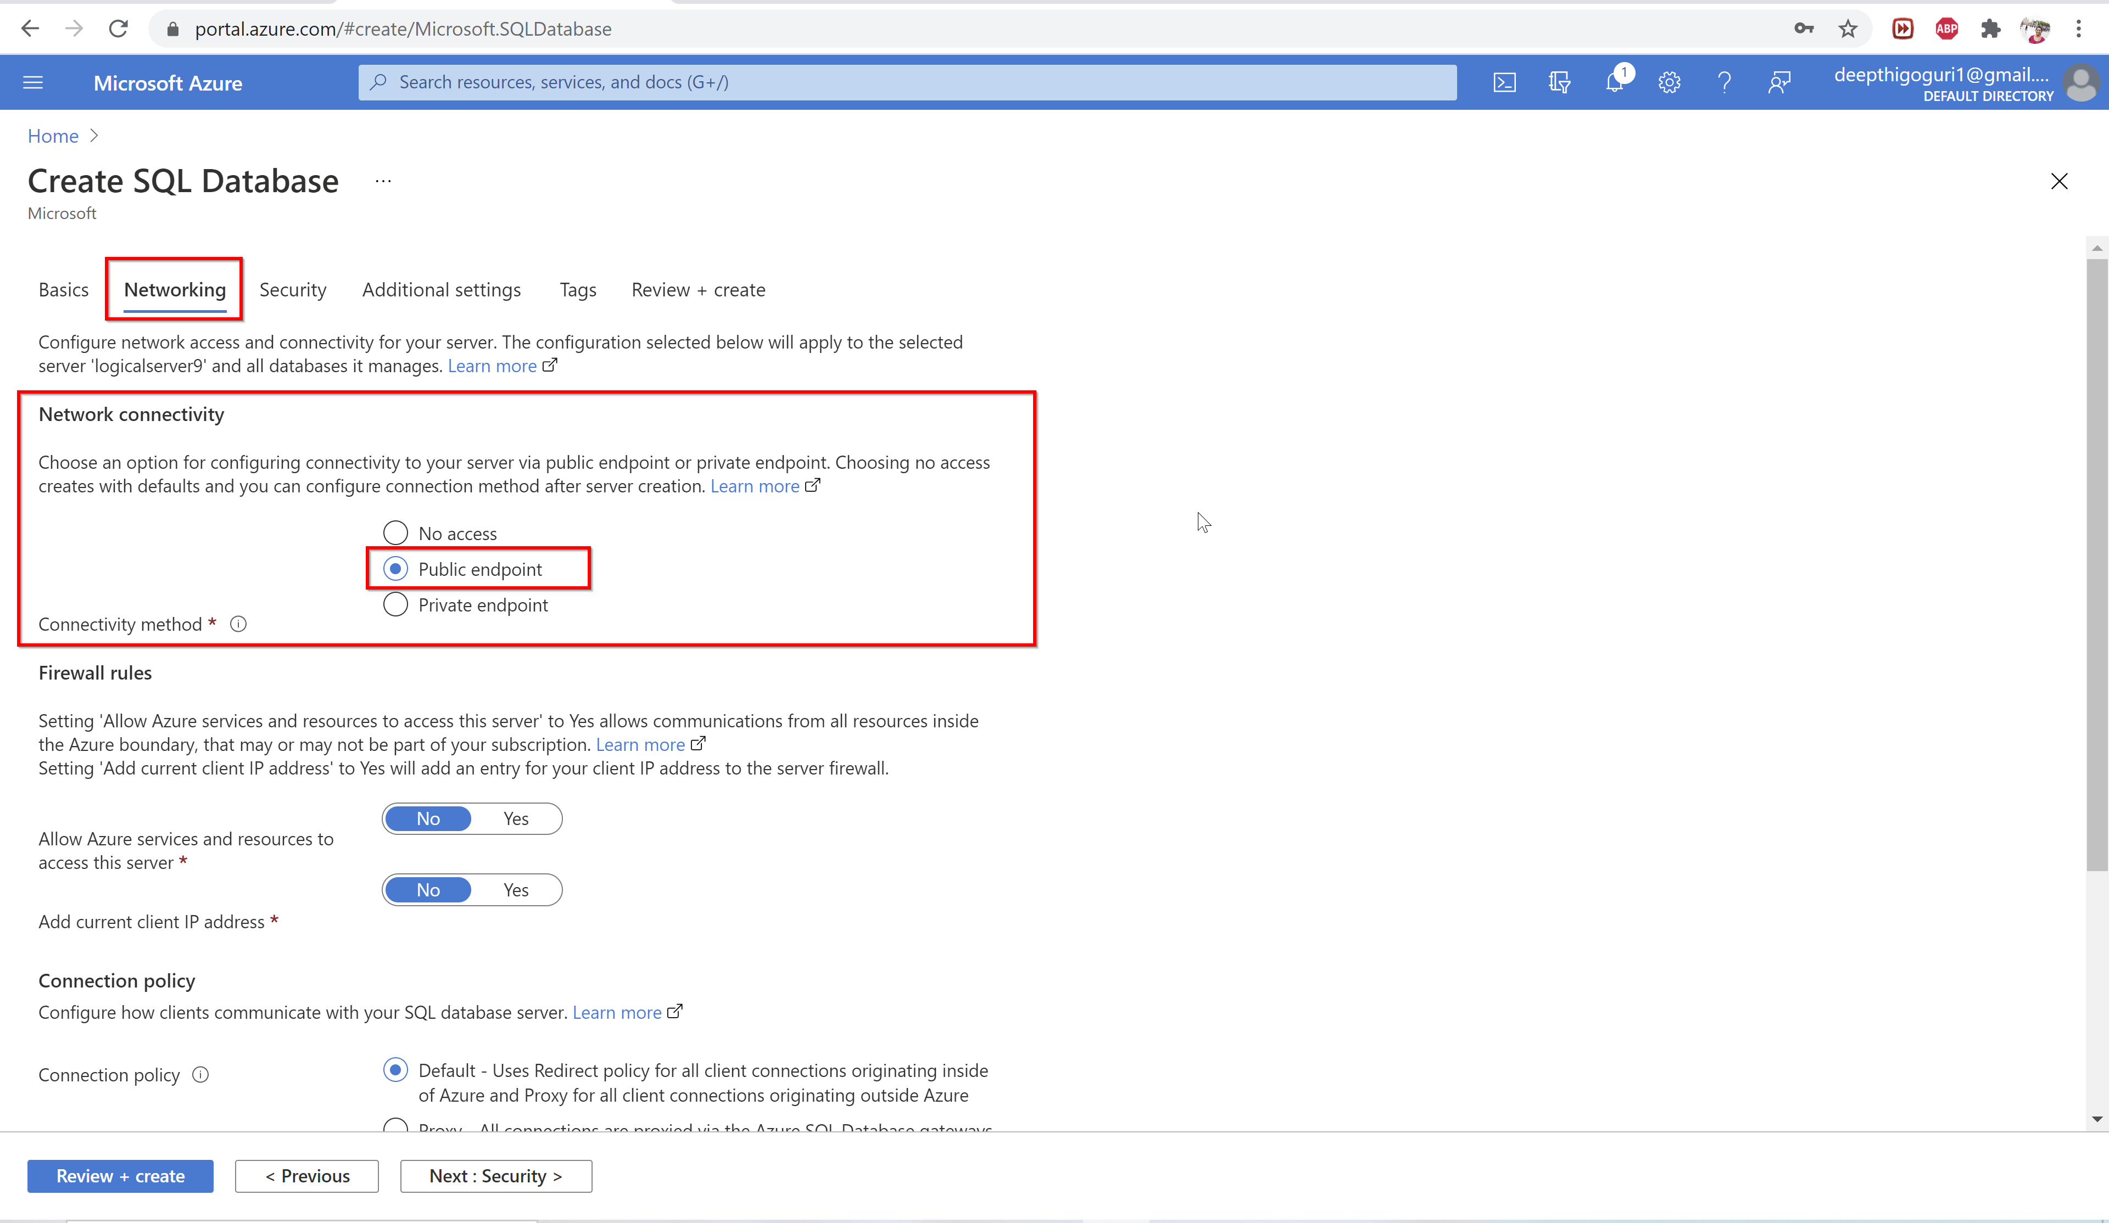

Slide 44
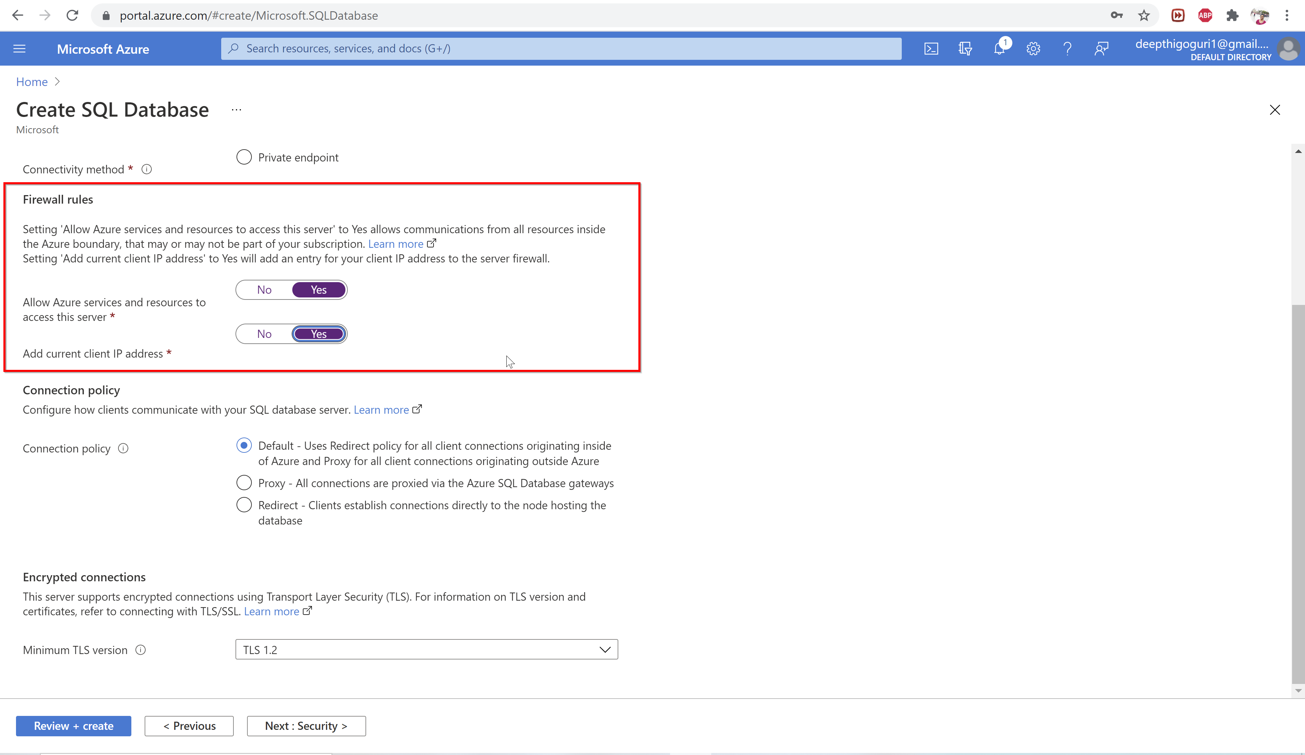

Slide 45
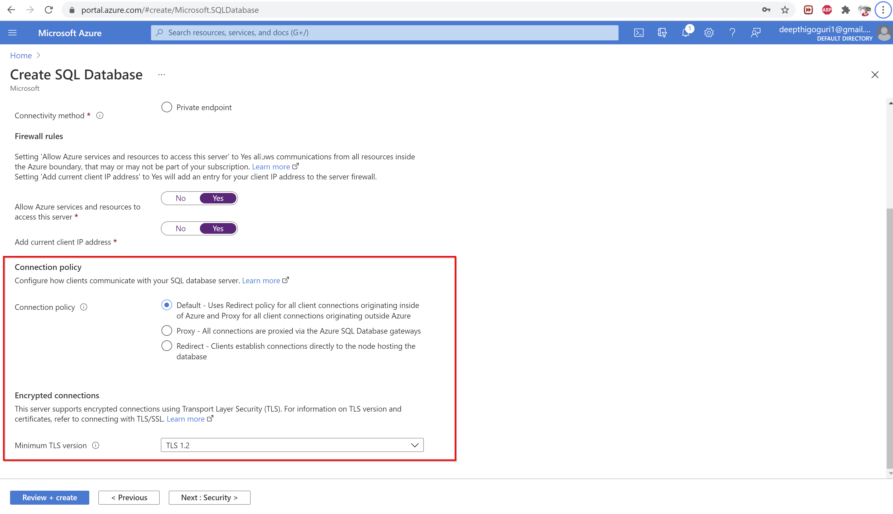

Slide 46
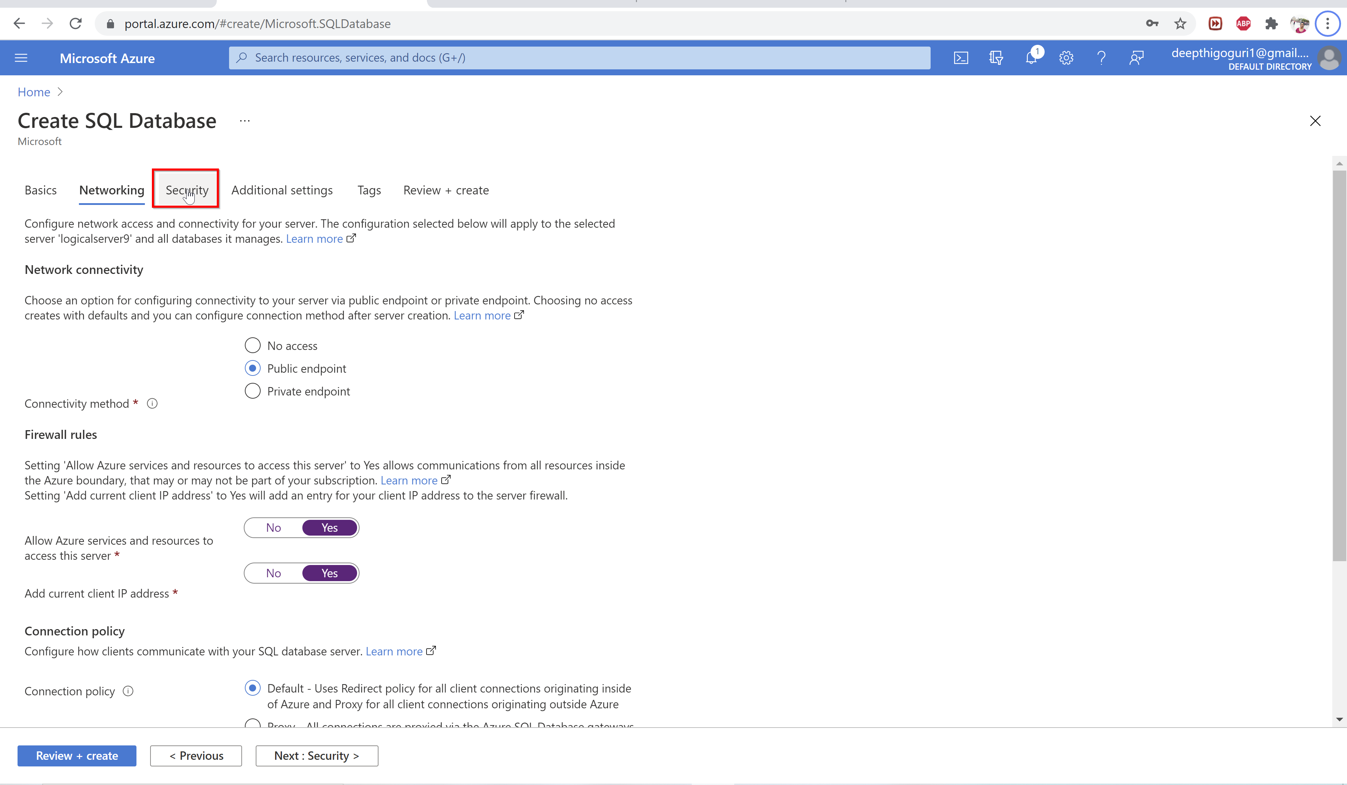

Slide 47
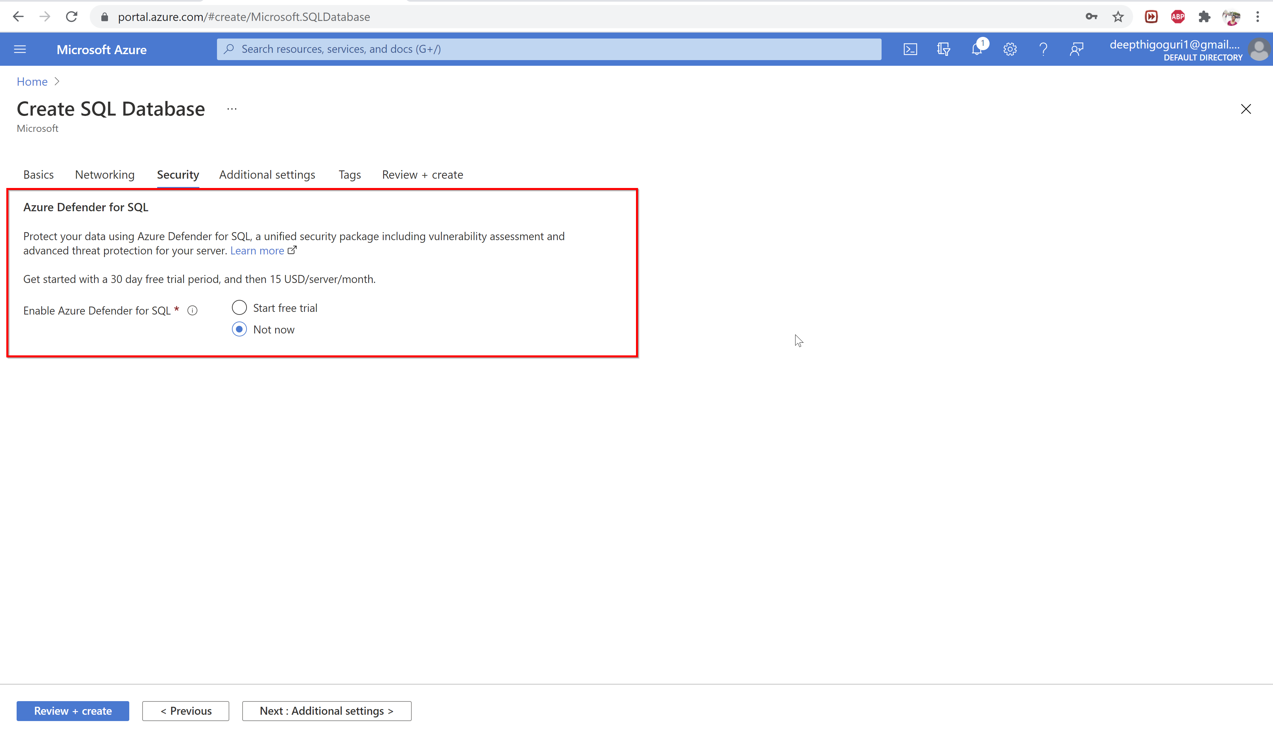

Slide 48
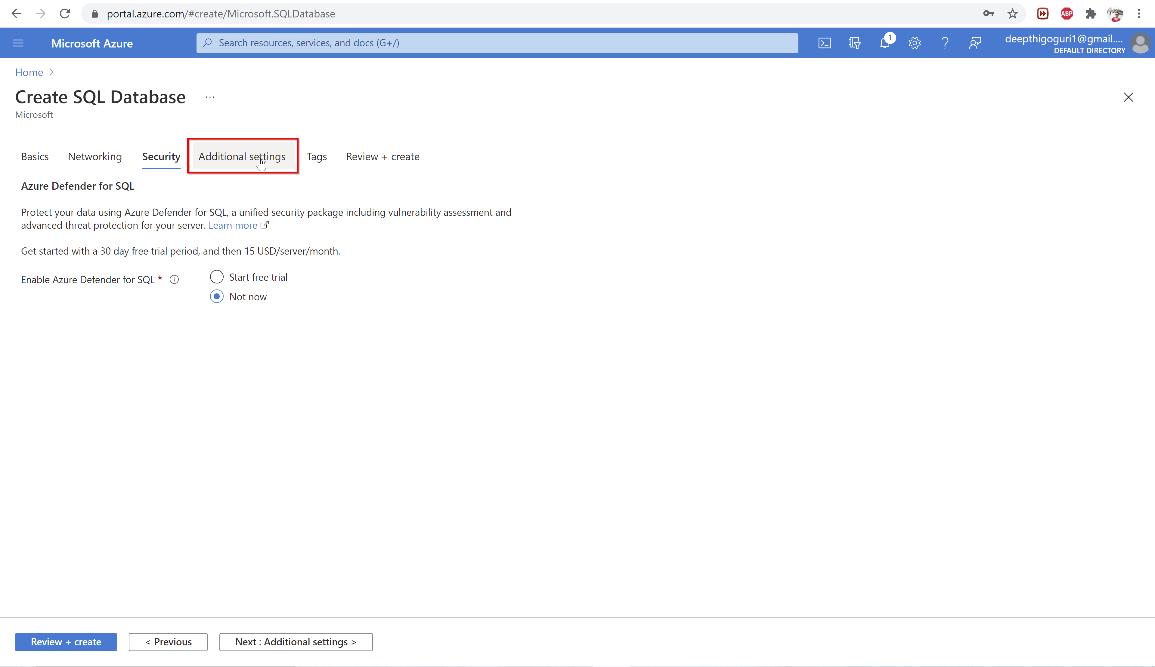

Slide 49
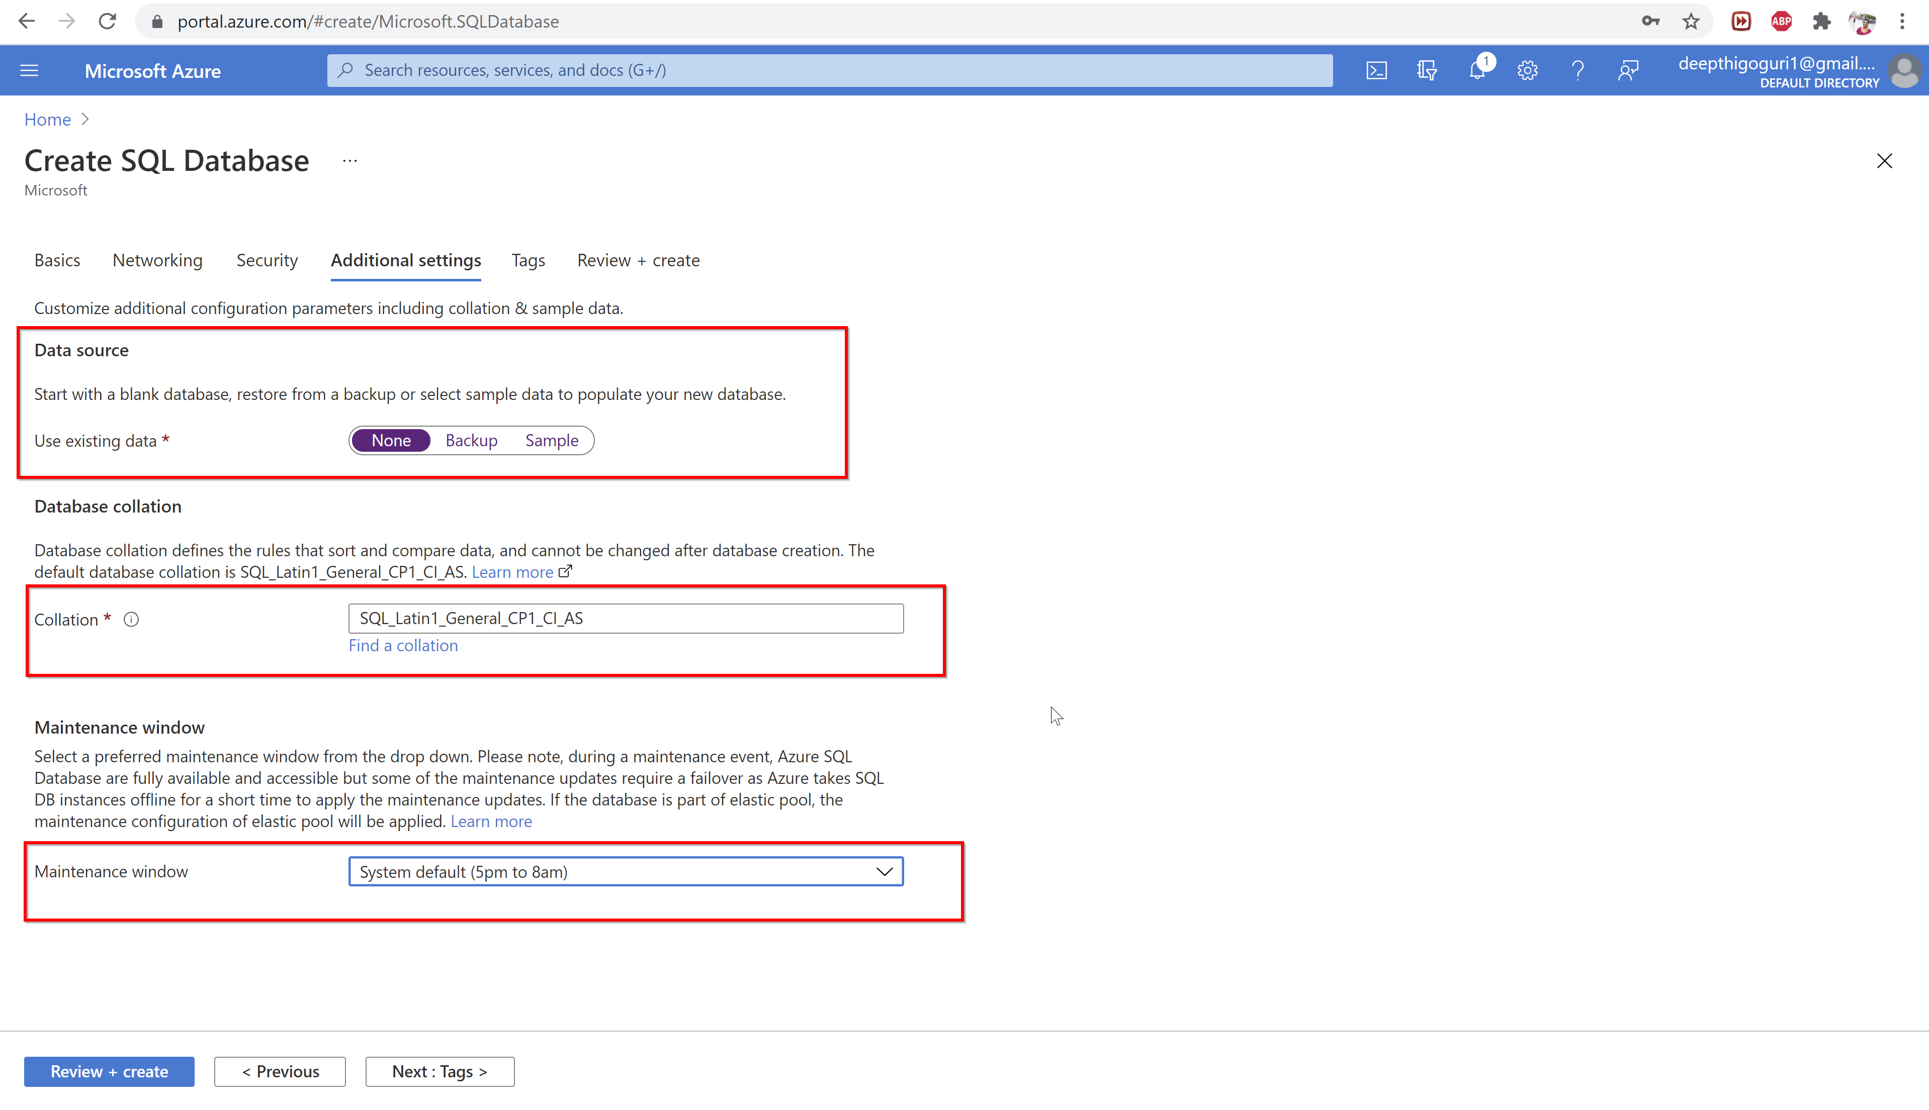

Slide 50
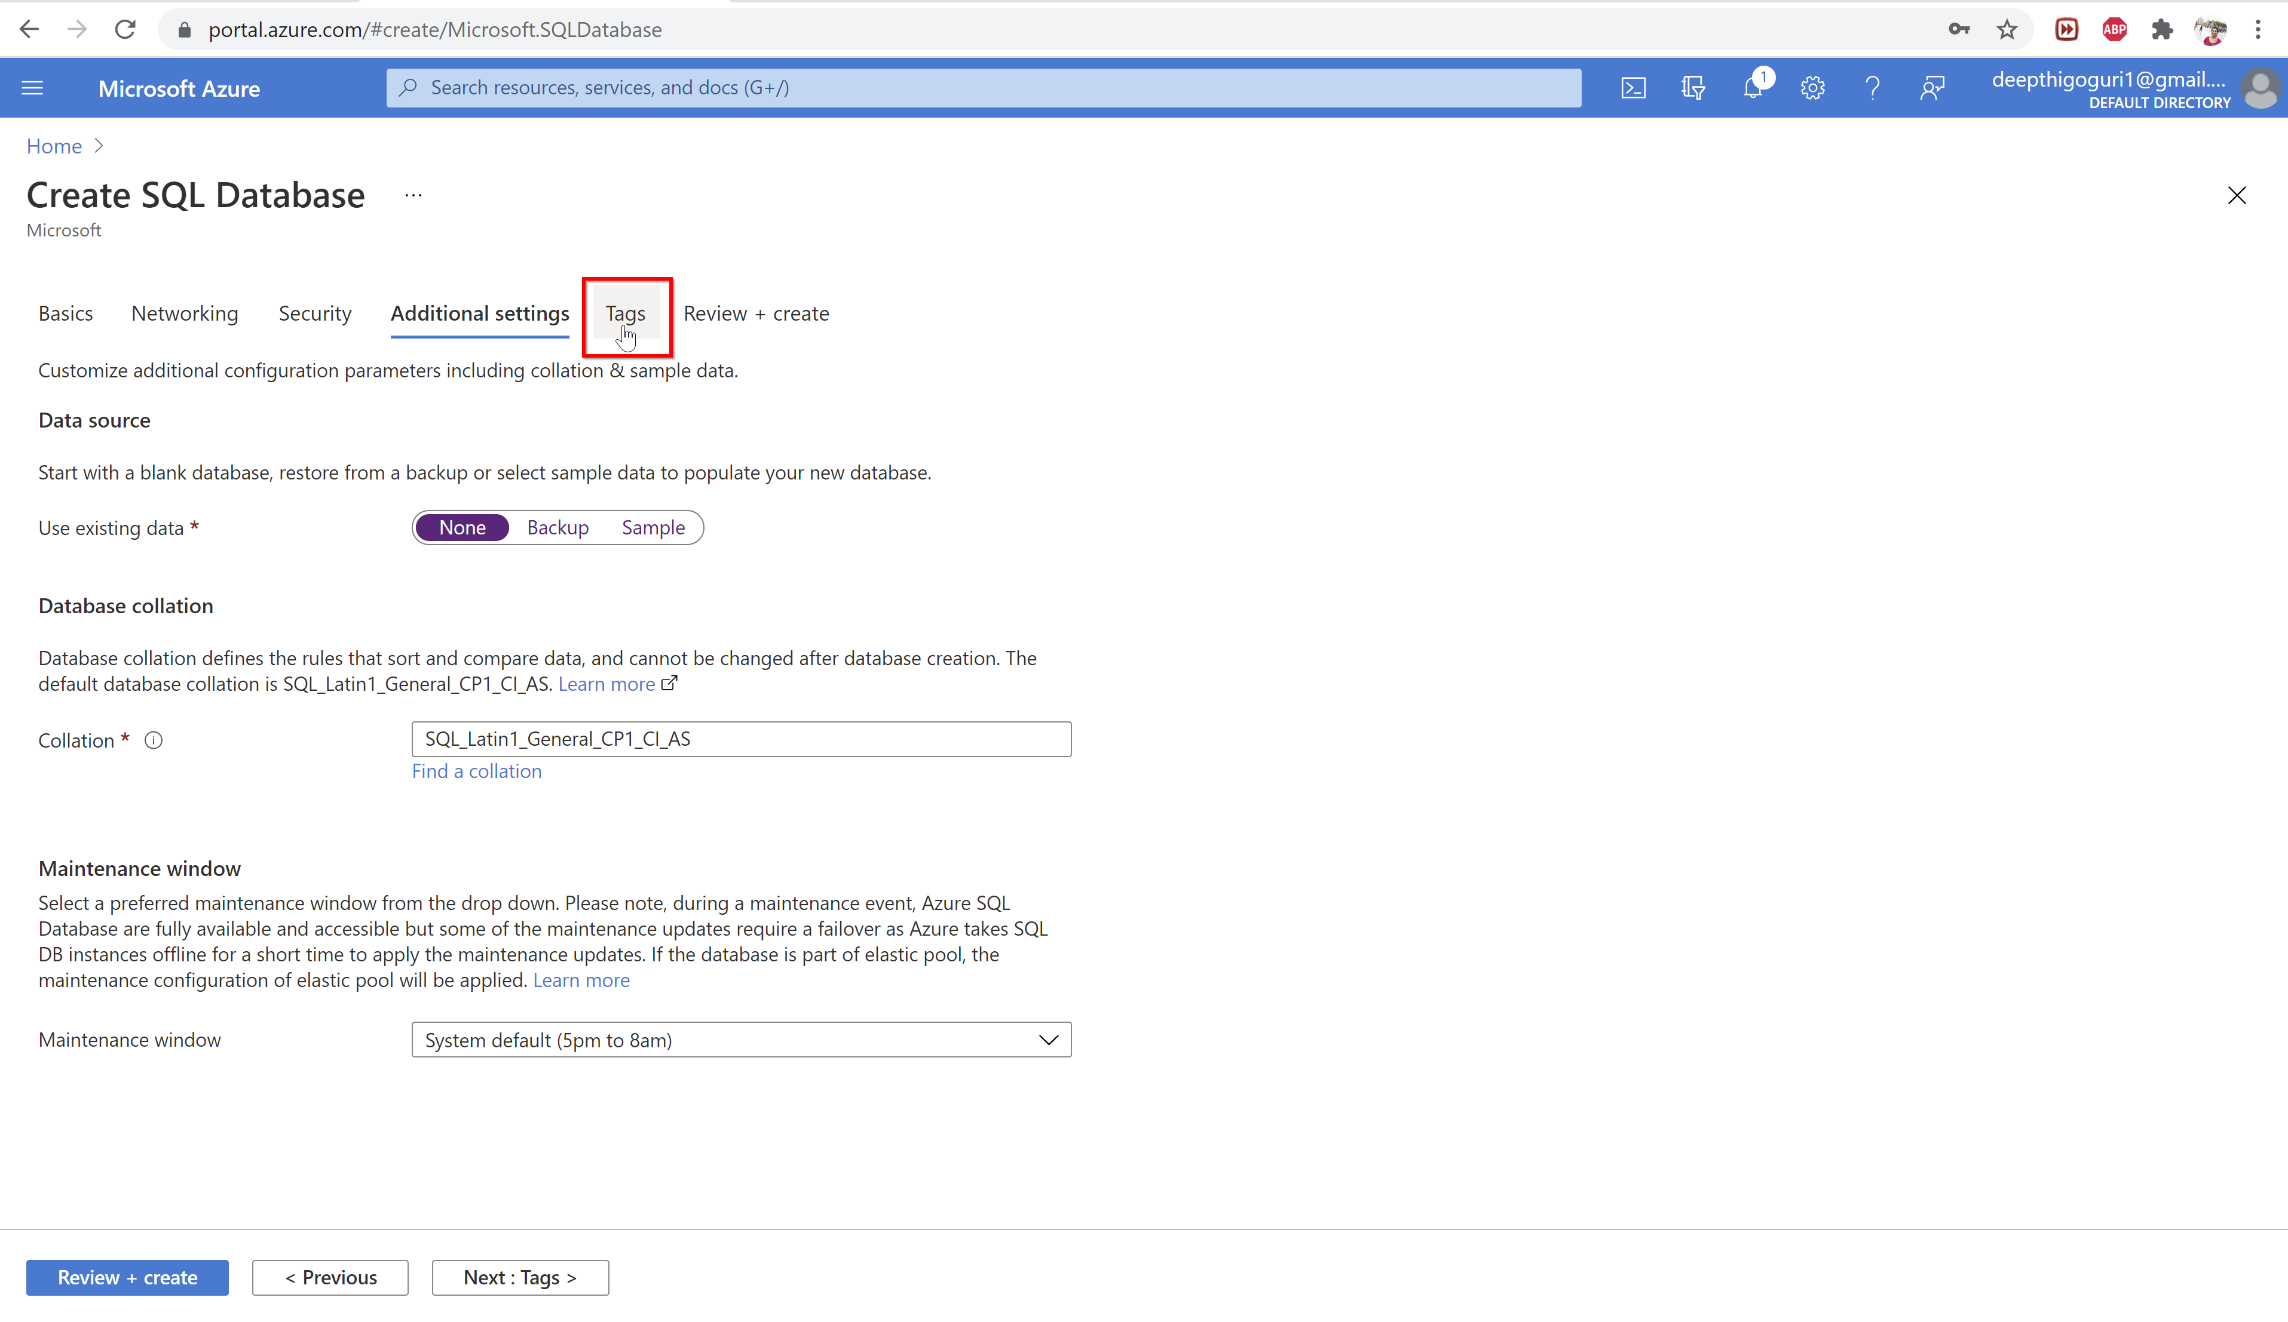

Slide 51
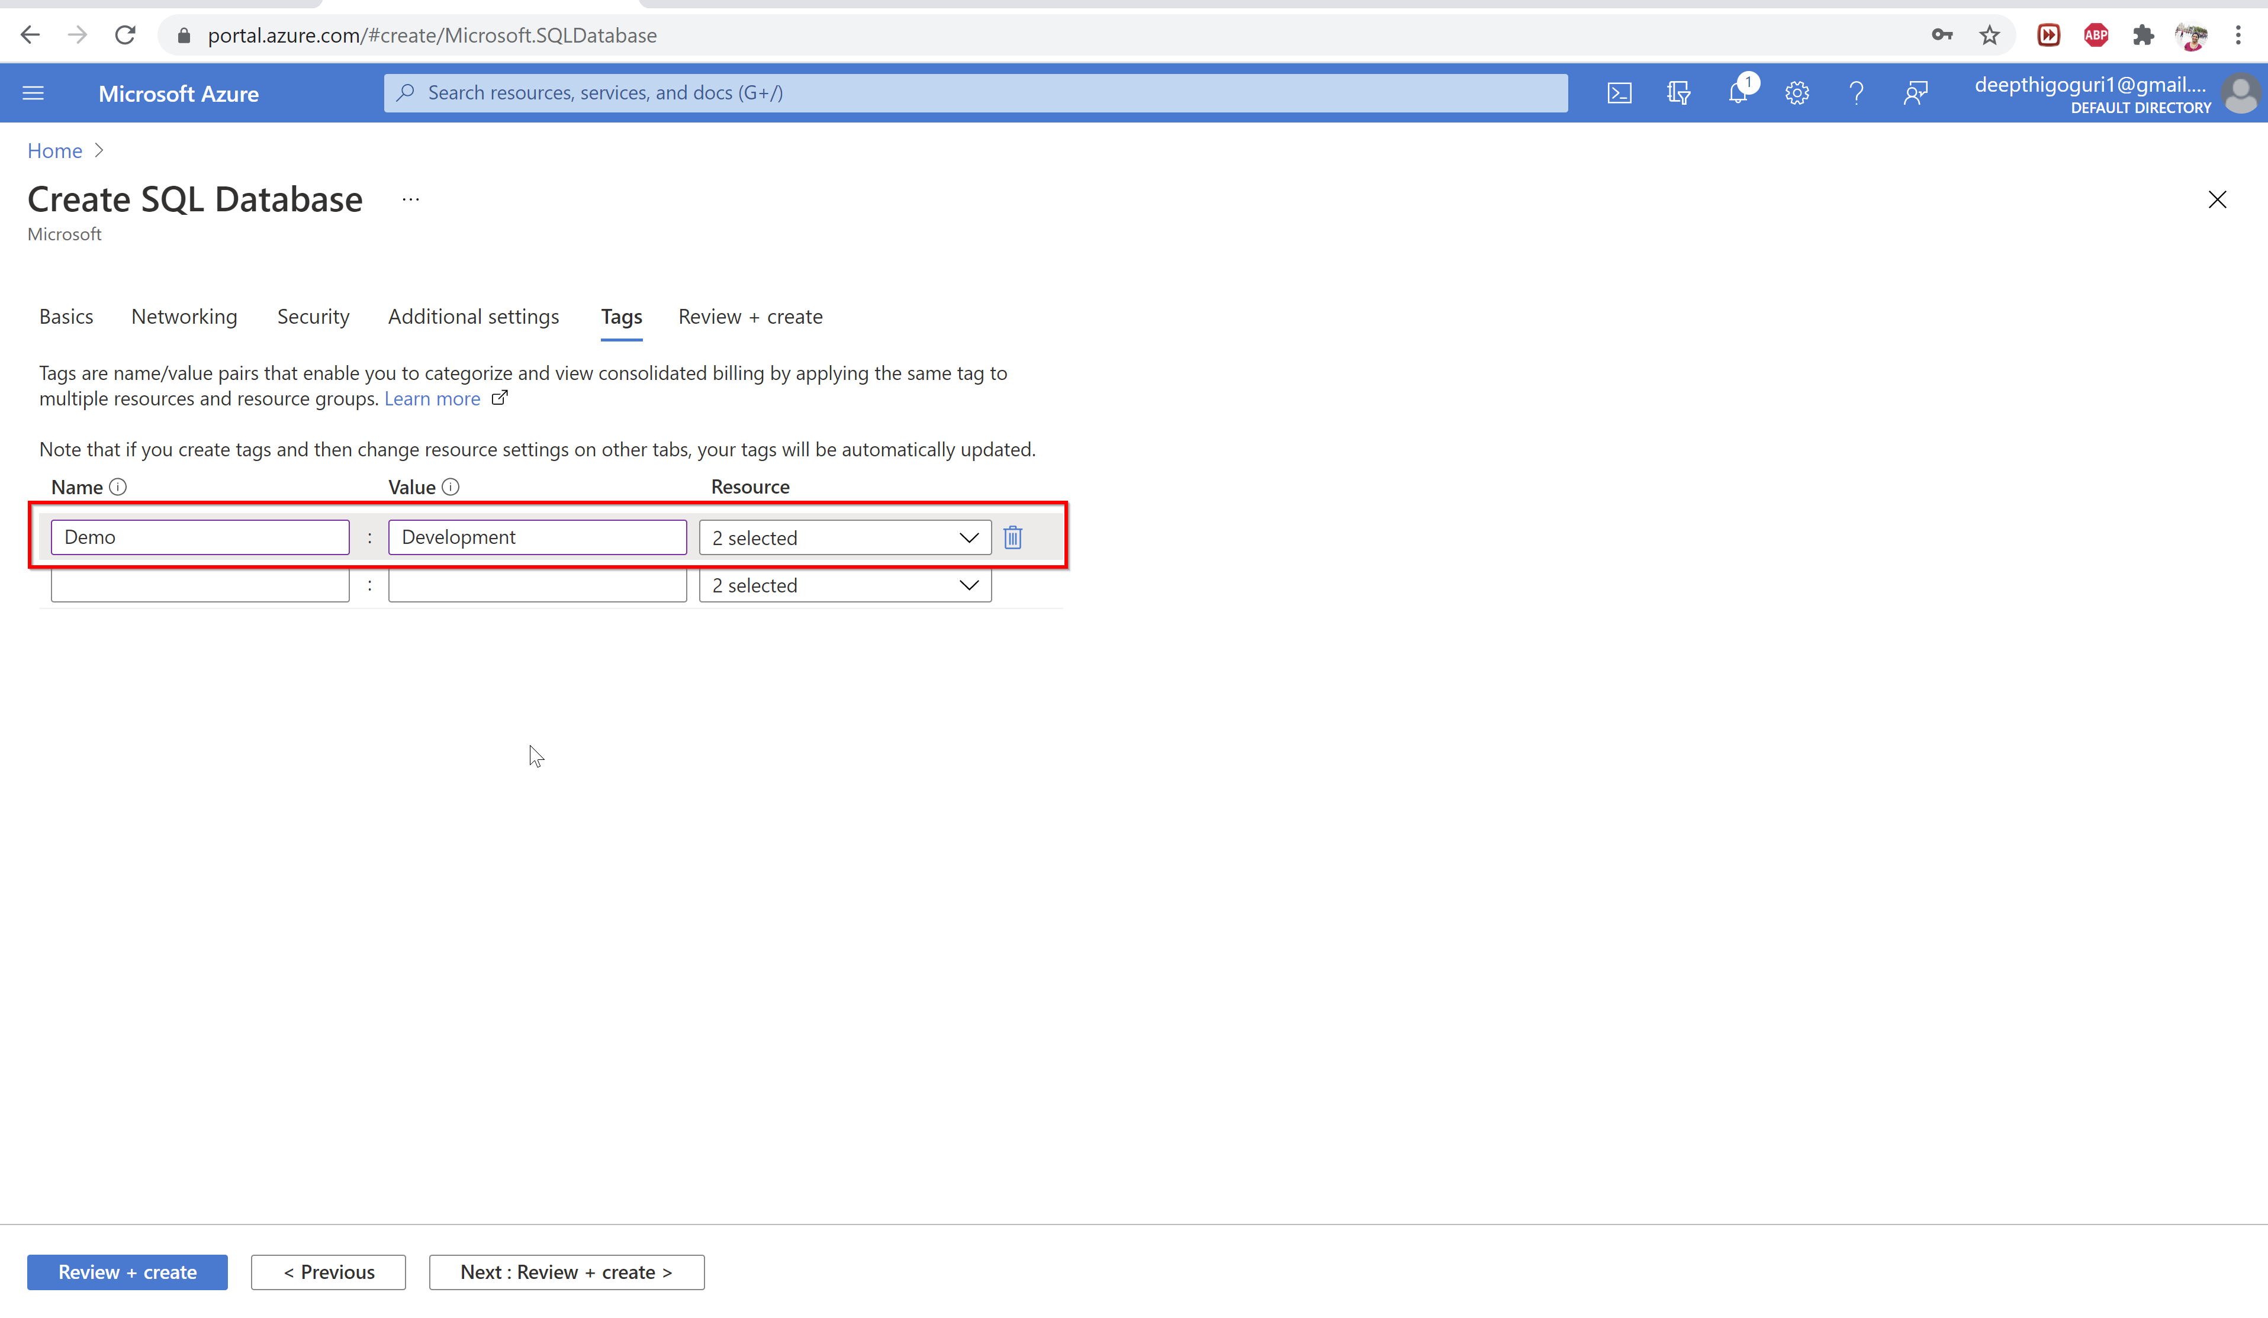

Slide 52
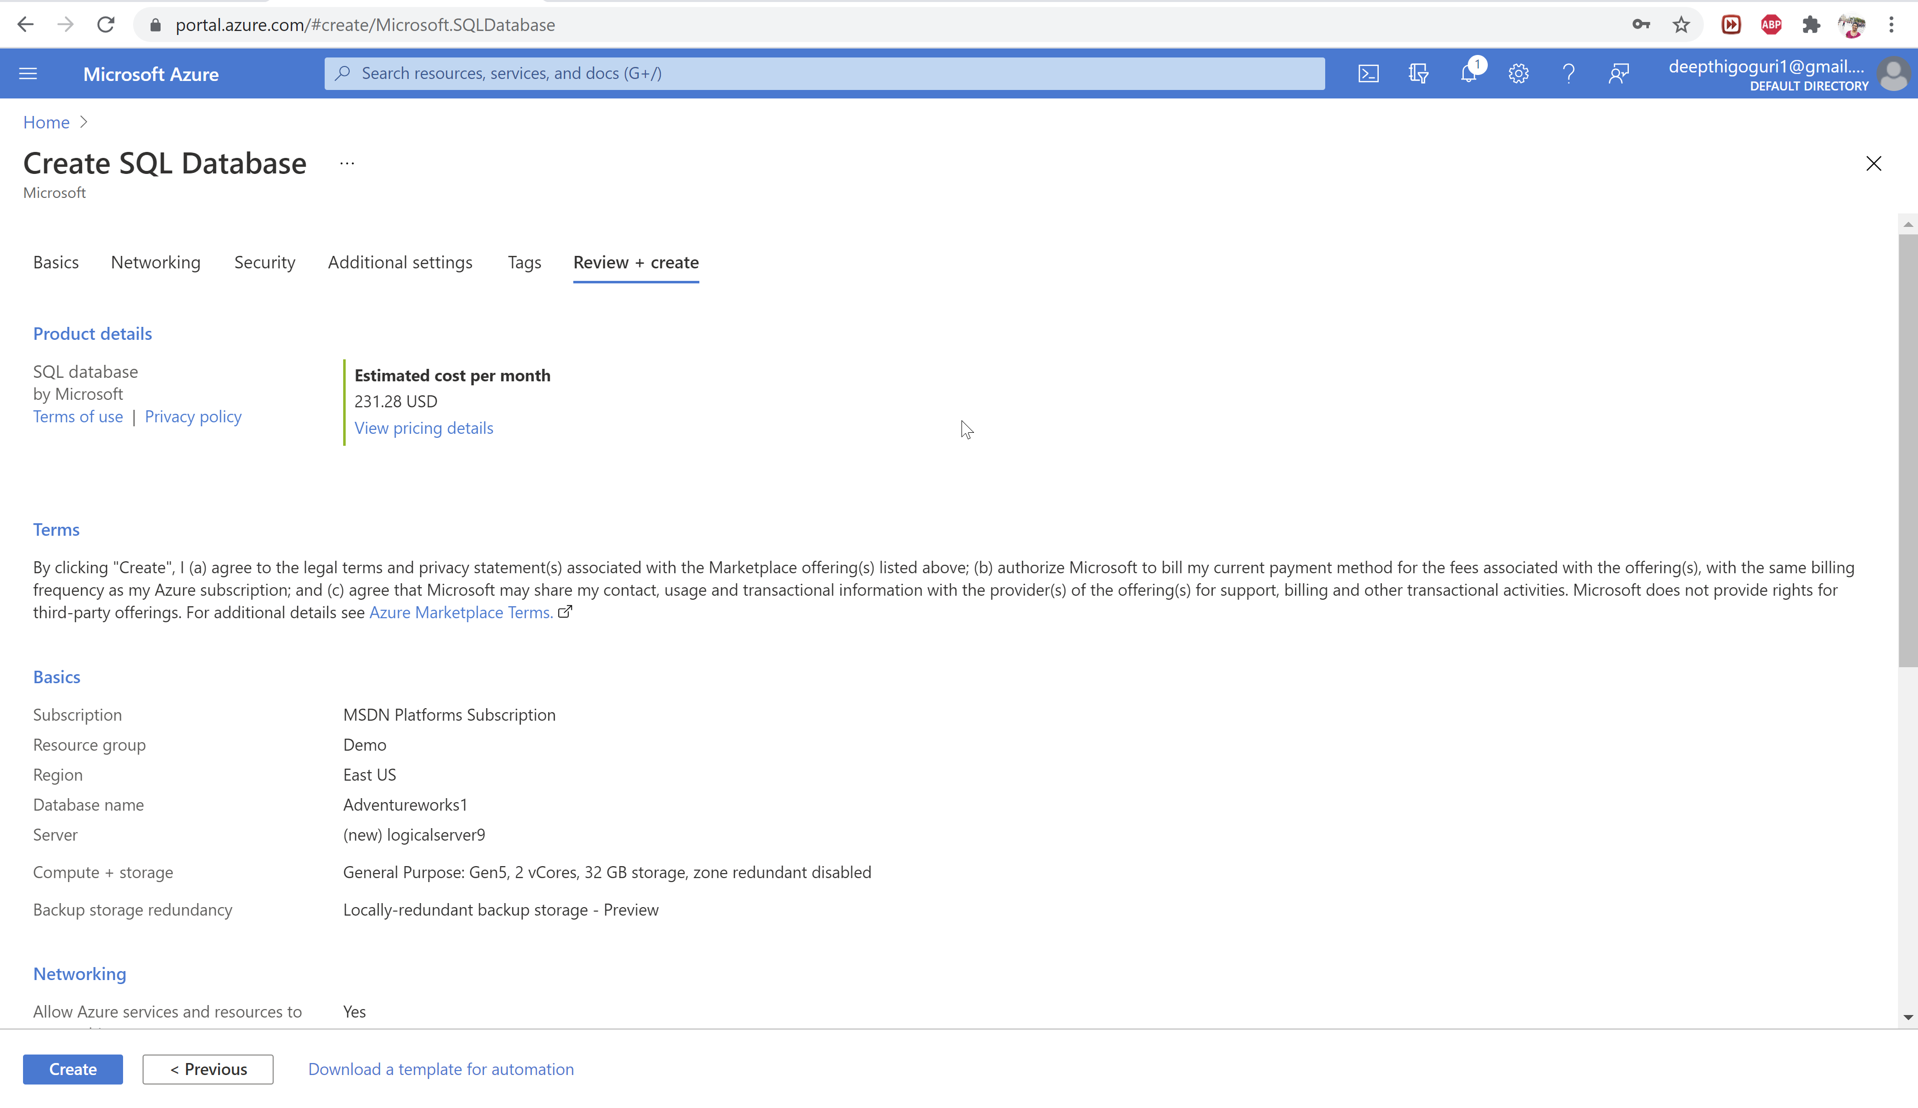

Slide 53
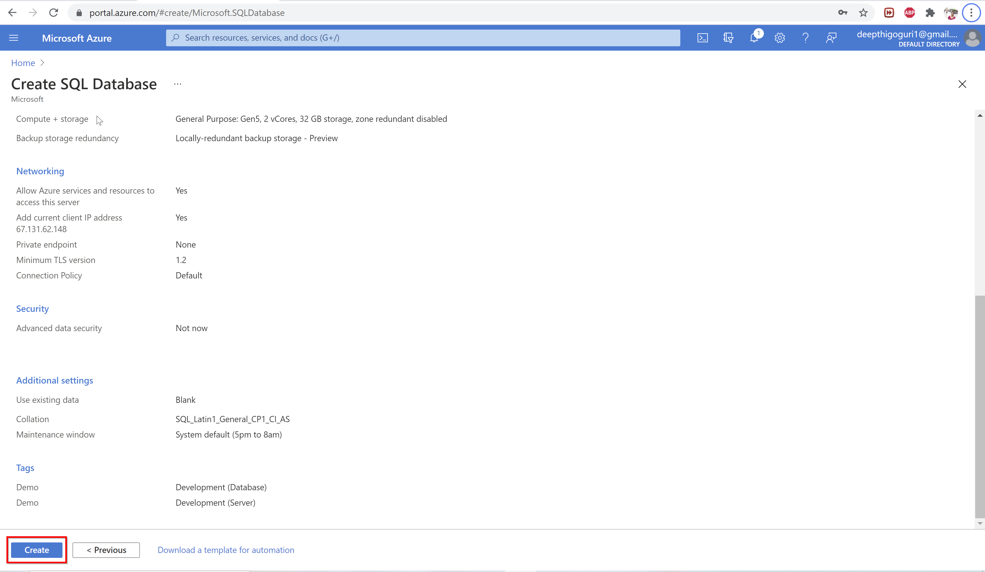

Slide 54
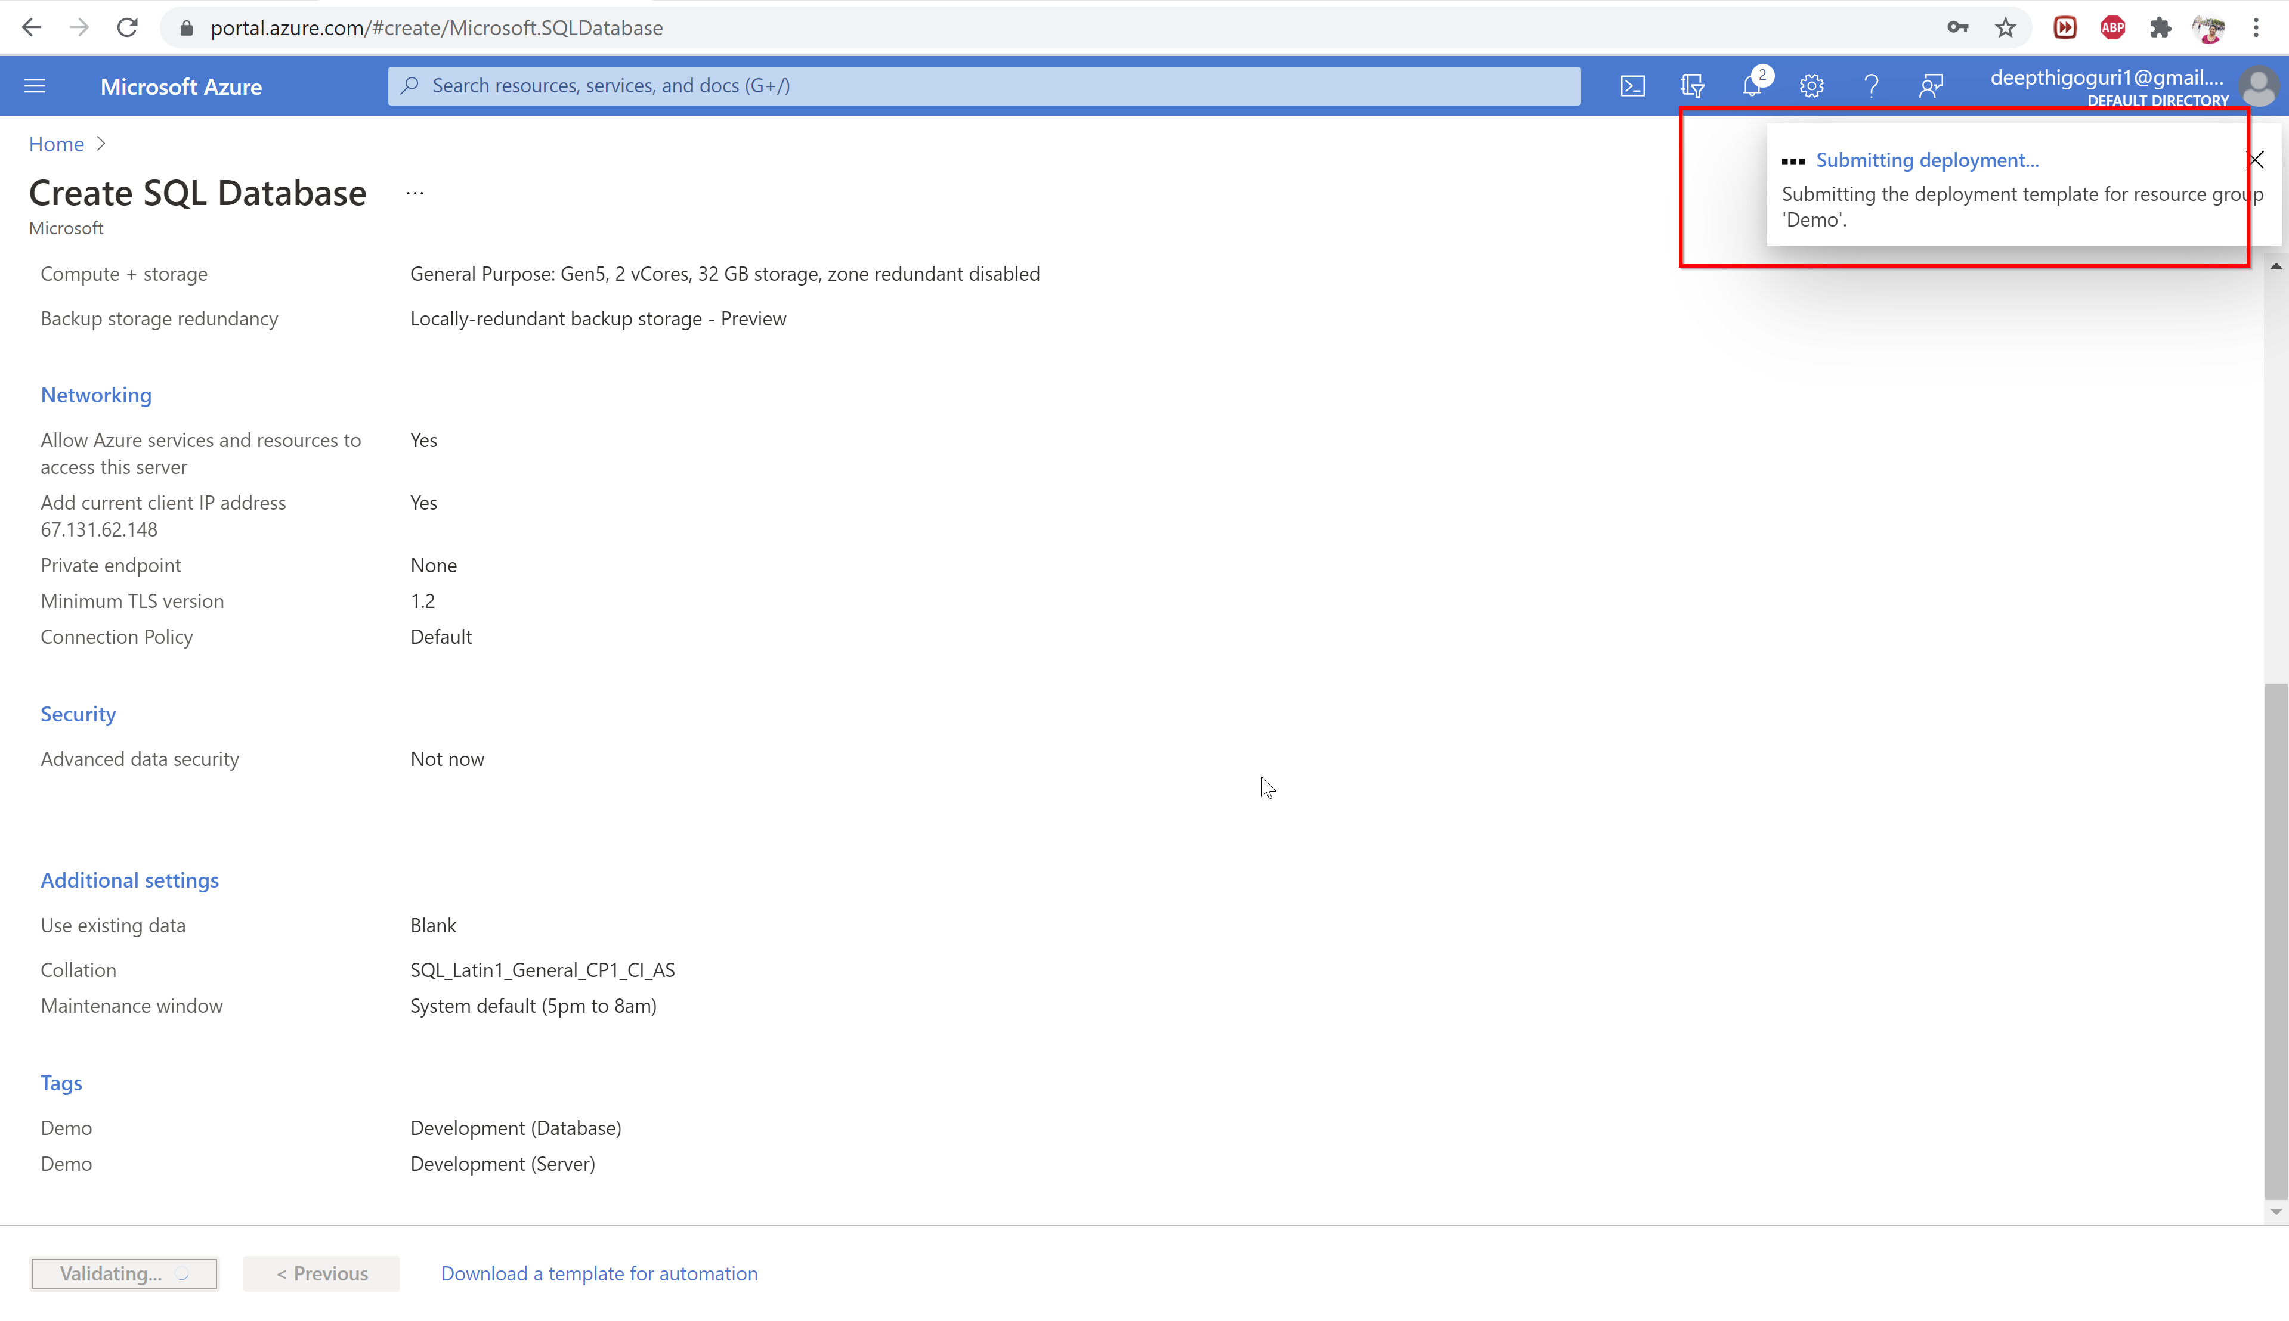

Slide 55
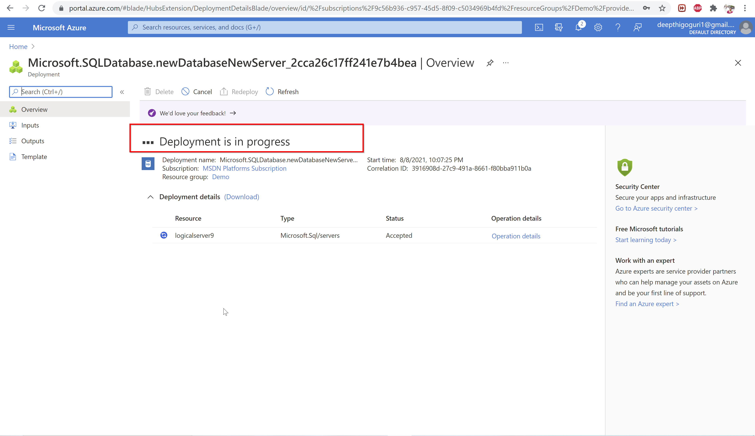

Slide 56
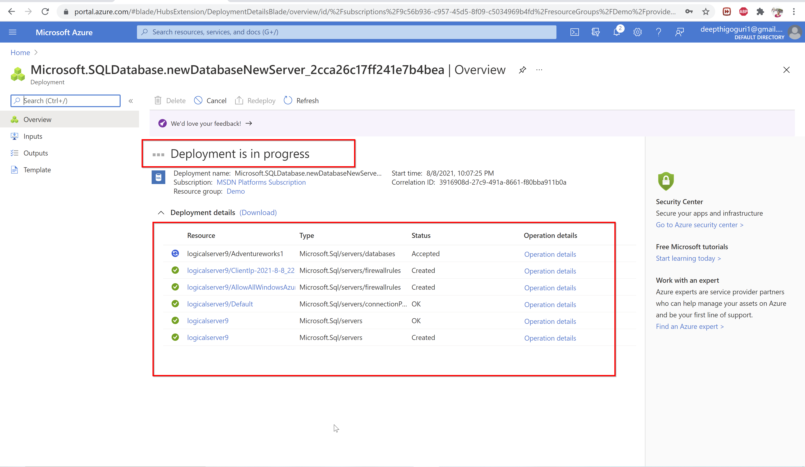

Slide 57
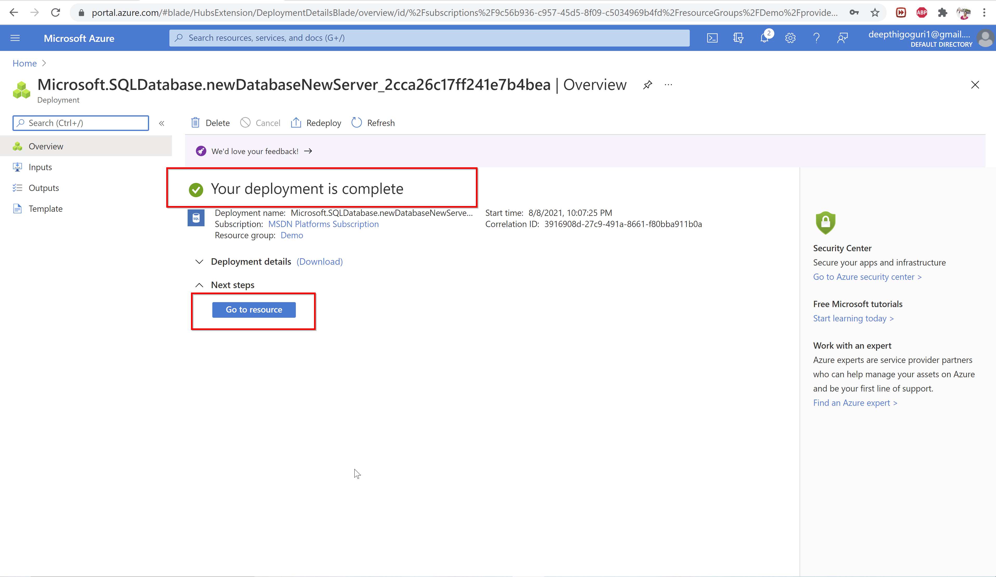

Slide 58
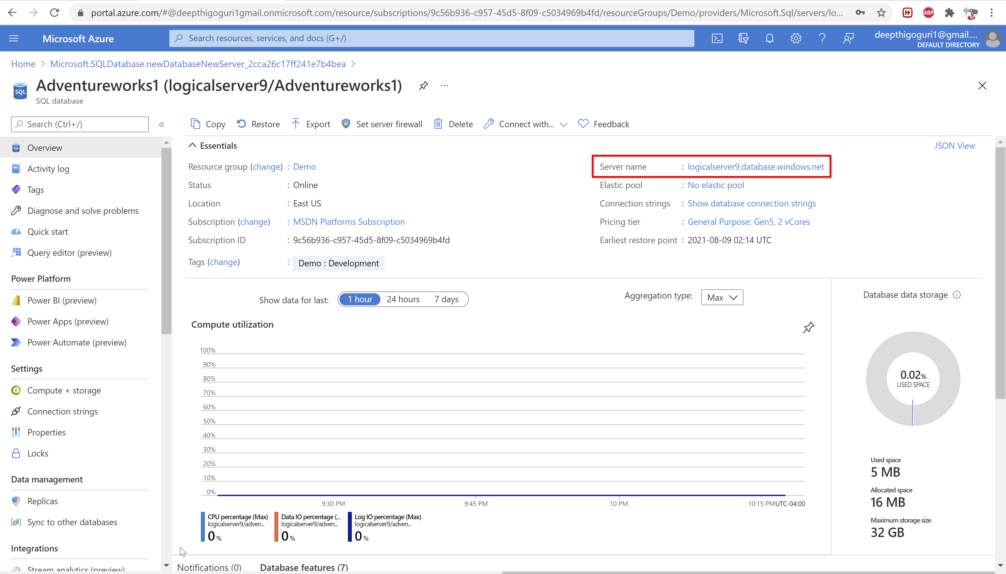

Slide 59
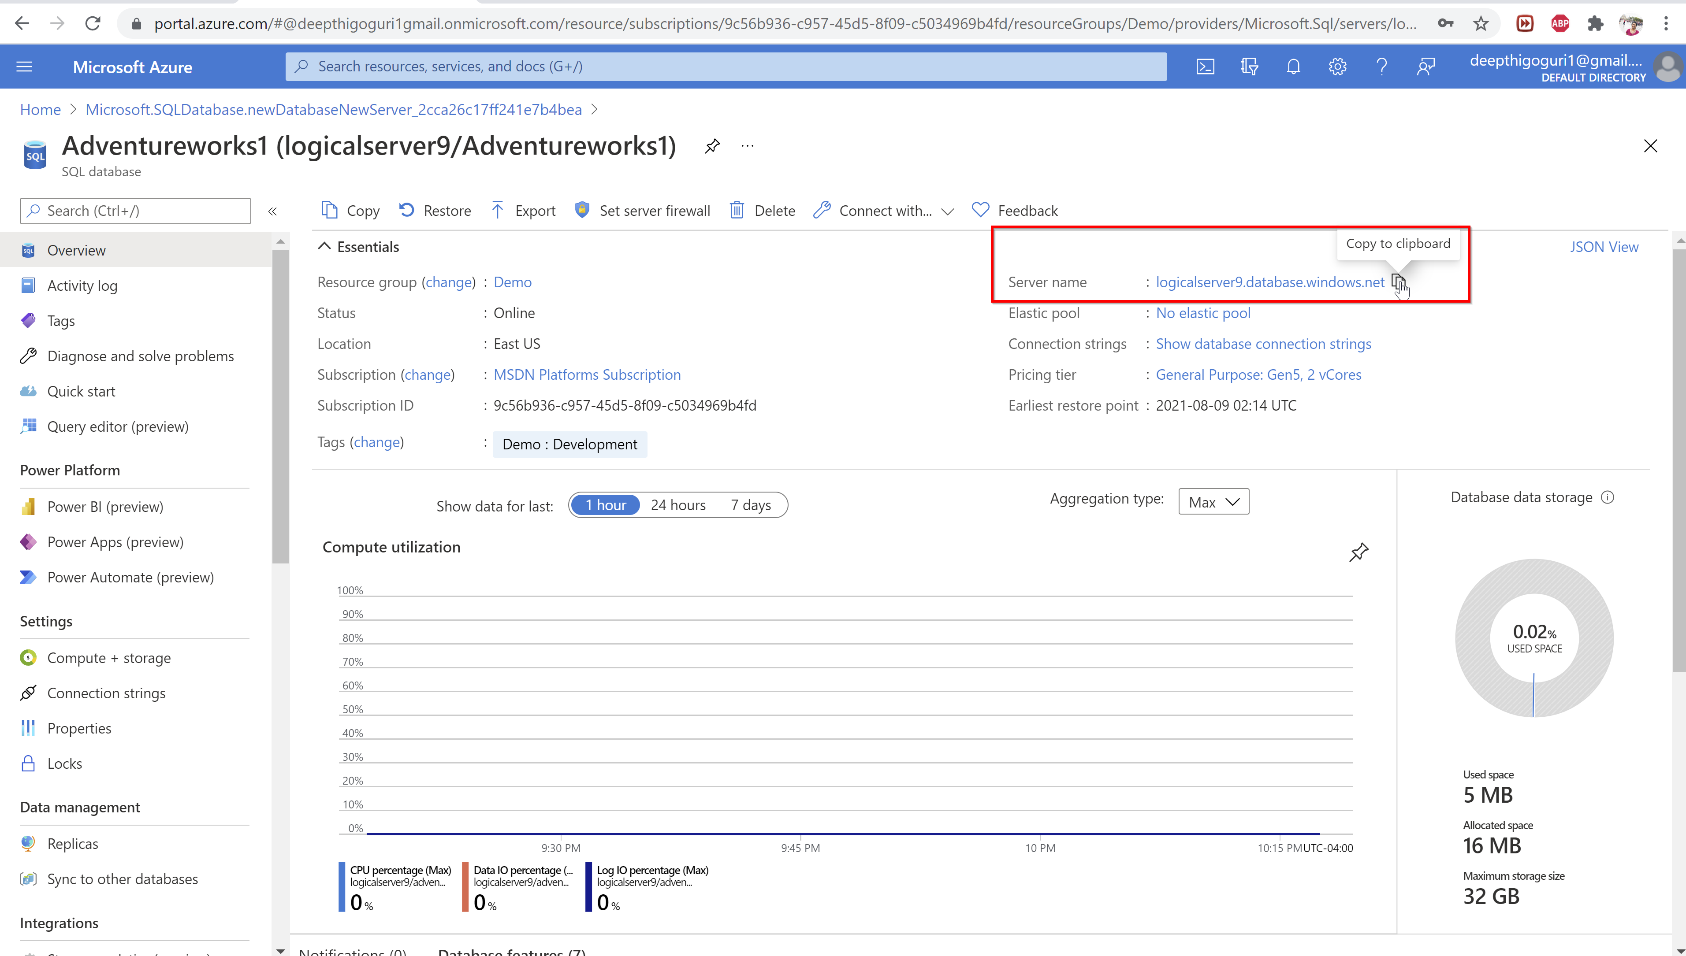

Slide 60
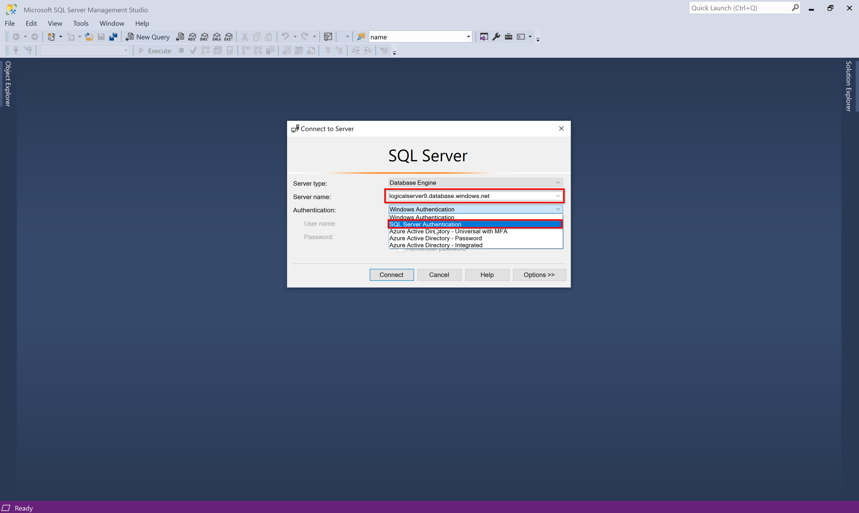

Slide 61
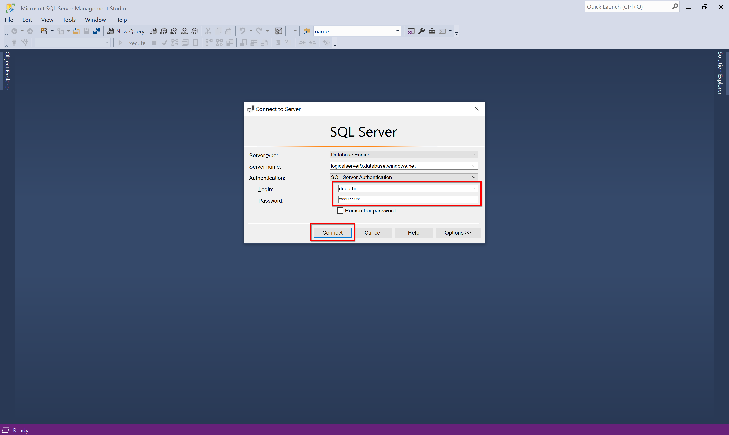

Slide 62
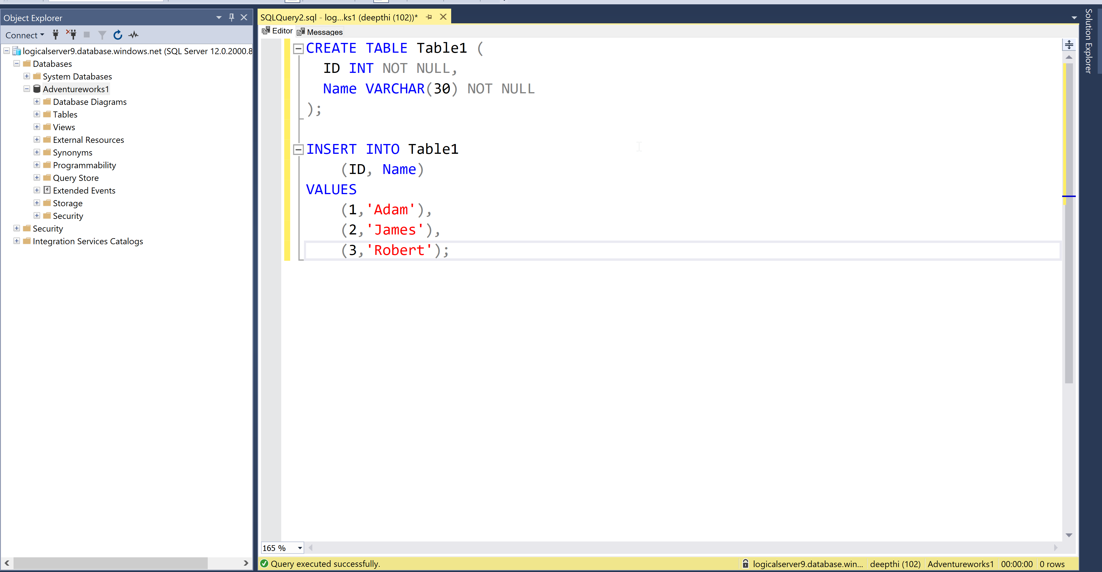

Slide 63
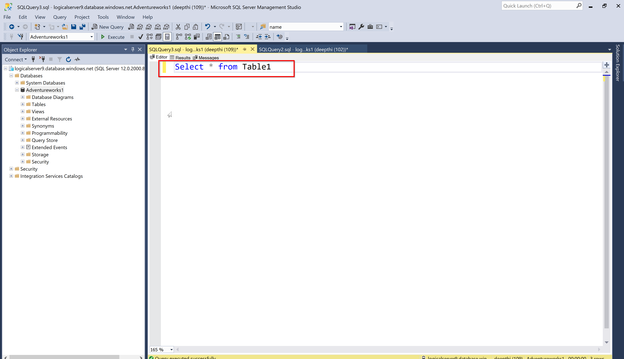

Slide 64
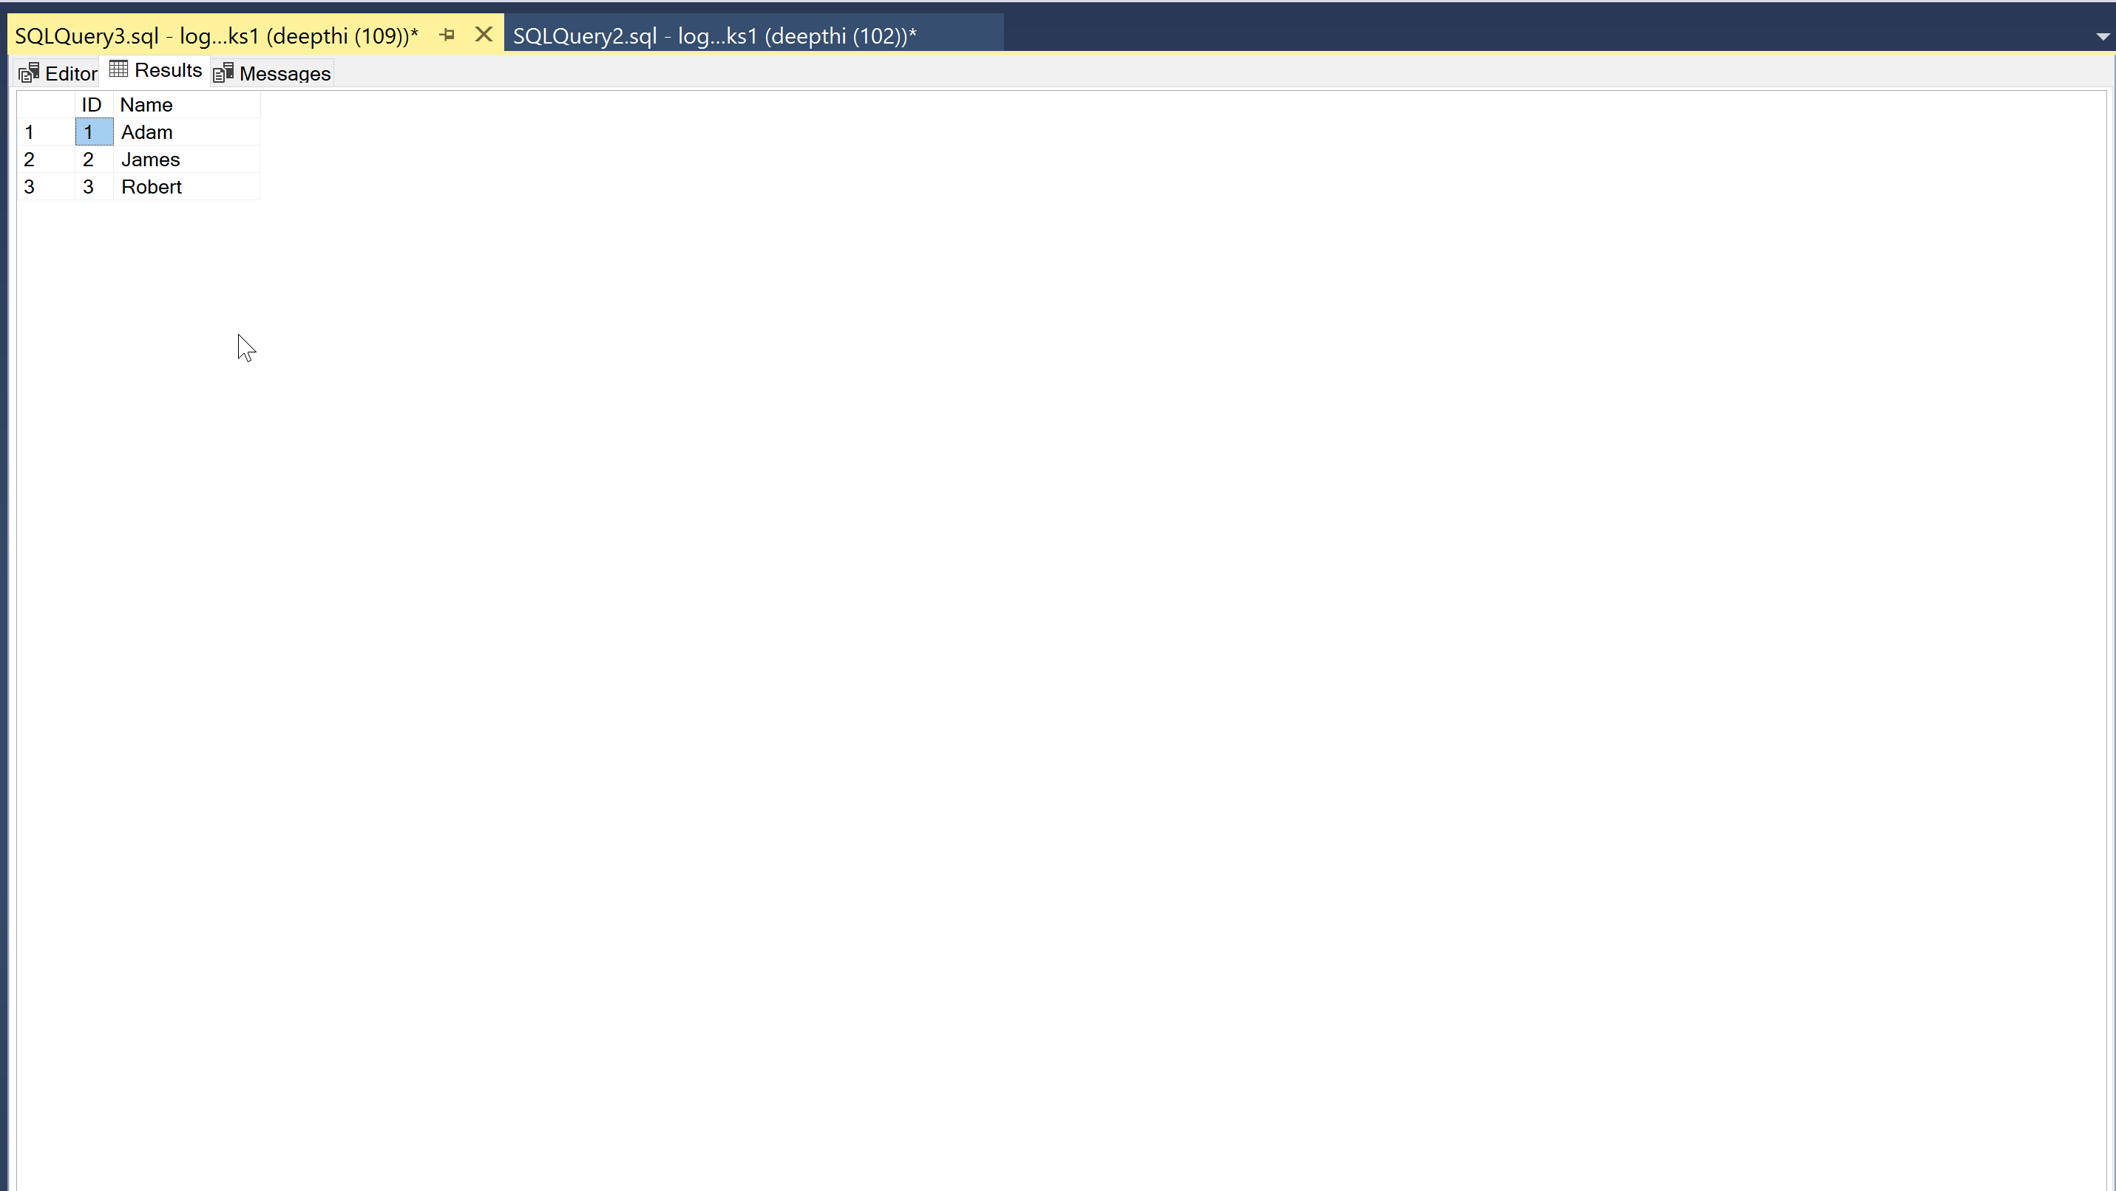

Slide 65
Backup and Restore

Slide 66
Backup and Restore
Globally replicated storage
Every week once – Full backup
Every 5-10 Minutes – T-logs
Every 12 hours once – Diff backup

Slide 67
How to take
manual backup?

Slide 68
Community Resources
Azure SQL Blog’s
Azure SQL YouTube https://www.youtube.com/playlist?list=PL3EZ3A8mHh0wcu2J1l5yHfkIsT-oVagf1
User Groups & Virtual Conferences
GitHub Resources
Workshops
Community #sqlfamily
Notes:
Discuss list of useful resources for further reading…
Azure Sql Youtube - https://www.youtube.com/playlist?list=PL3EZ3A8mHh0wcu2J1l5yHfkIsT-oVagf1

Slide 69
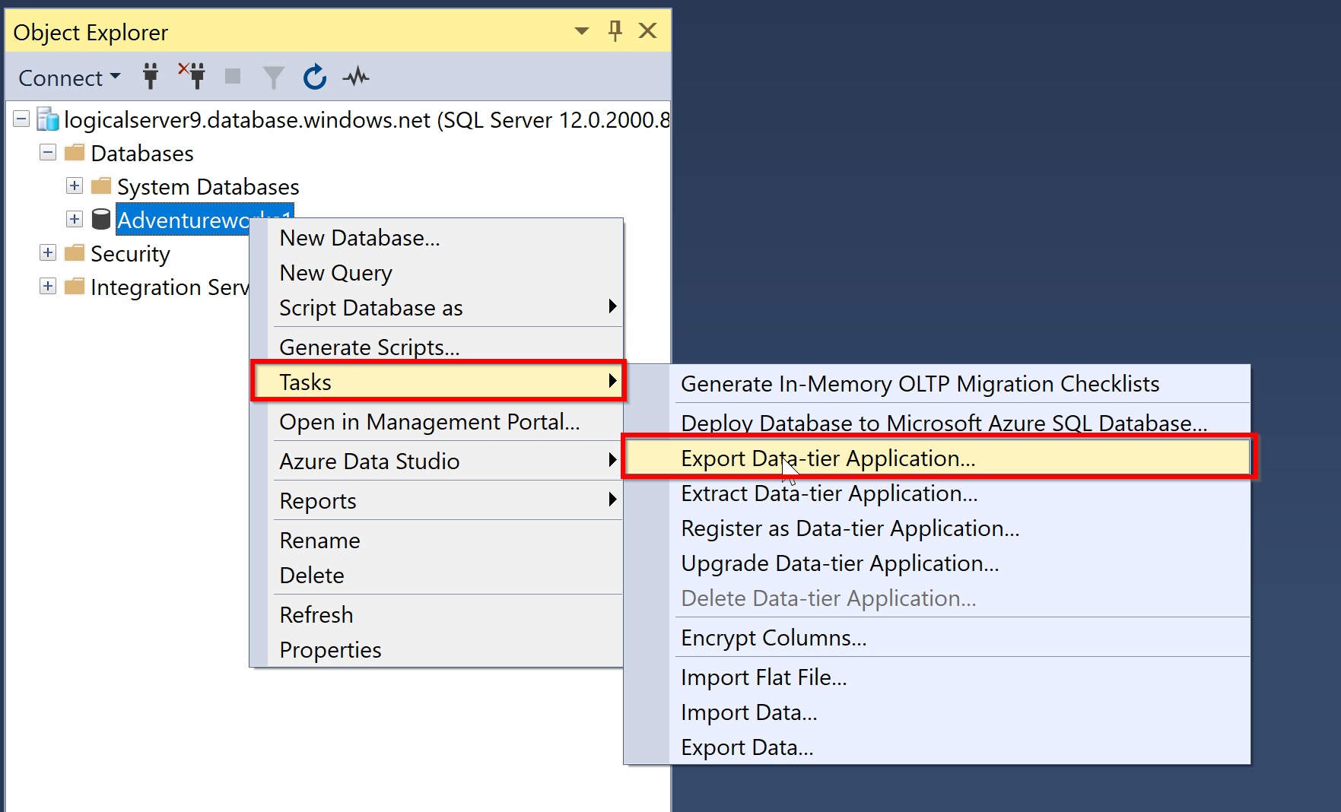

Slide 70
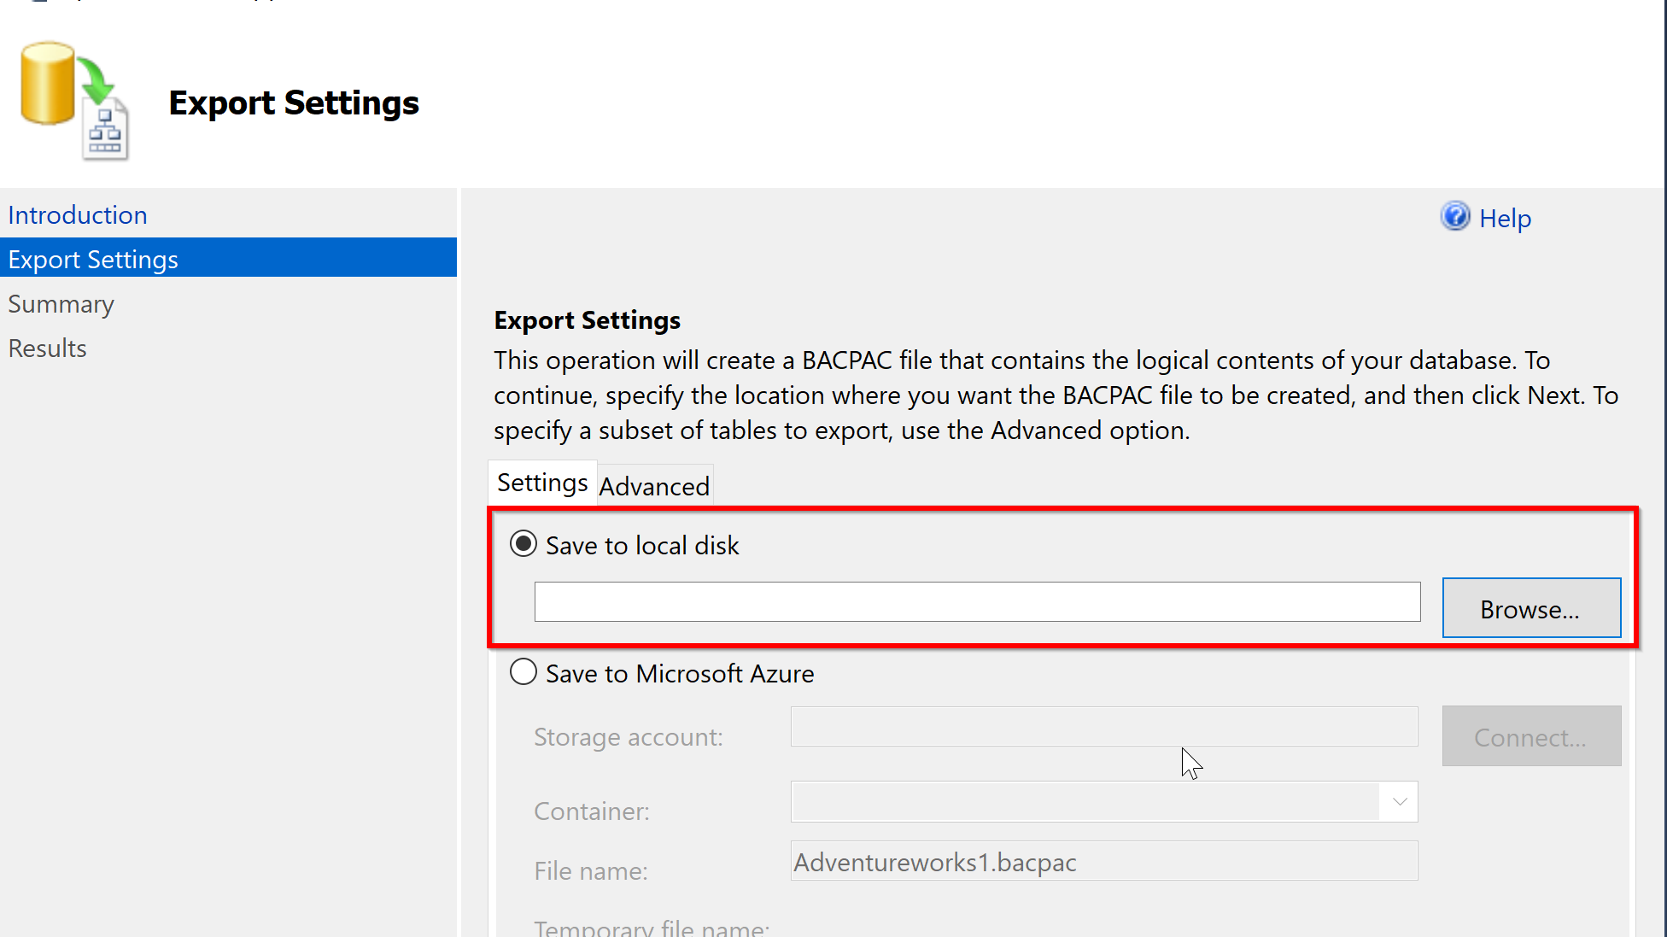

Slide 71
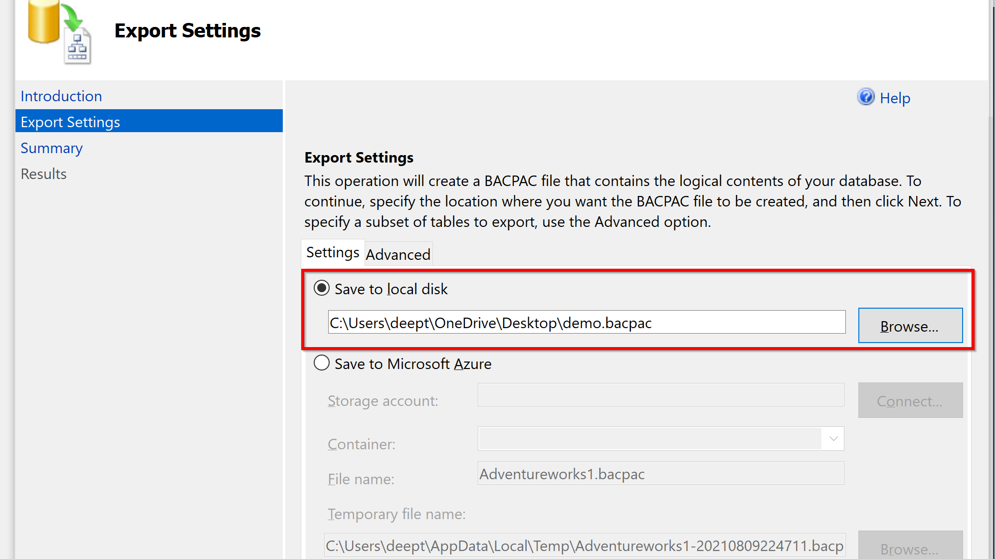

Slide 72


Slide 73
Backup using
Azure Data studio
Notes:
Ok lets spend the majority of time looking at some demo’s

Slide 74


Slide 75
Tools for migration
Notes:
Ok lets spend the majority of time looking at some demo’s

Slide 76
Tools for migration
Azure TCO (Total cost of Ownership) calculator for estimating the costs
Migrations: SKU recommender Azure SQL
Data Migration Assistant-Check for any compatibility issues
SQL Azure Migration Wizard
Azure Database Migration Services

Slide 77
Key Takeaways
Azure SQL is cool
Easy to Learn
Anyone can get started
Intelligent Performance
Saves money
Less Maintenance

Slide 78
Start your Azure journey
Microsoft Docs
Microsoft Learn TV
Channel9
Azure SQL Fundamentals
SQL Workshops
Azure SQL
Microsoft Virtual Training Days

Slide 79
Resources
https://docs.microsoft.com/en-us/learn/paths/azure-sql-fundamentals/

Slide 80
Contact Details
Twitter: https://twitter.com/dbanuggets
LinkedIn: https://www.linkedin.com/in/deepthigoguri/
Blog: https://dbanuggets.com/
Notes:
Feel free to reach out to me if you have any further questions

Slide 81
Thank You!

